Slide 1
Pyspark: Module-6

Slide 2
Pyspark | Delta Lake: Time Travel

Slide 3
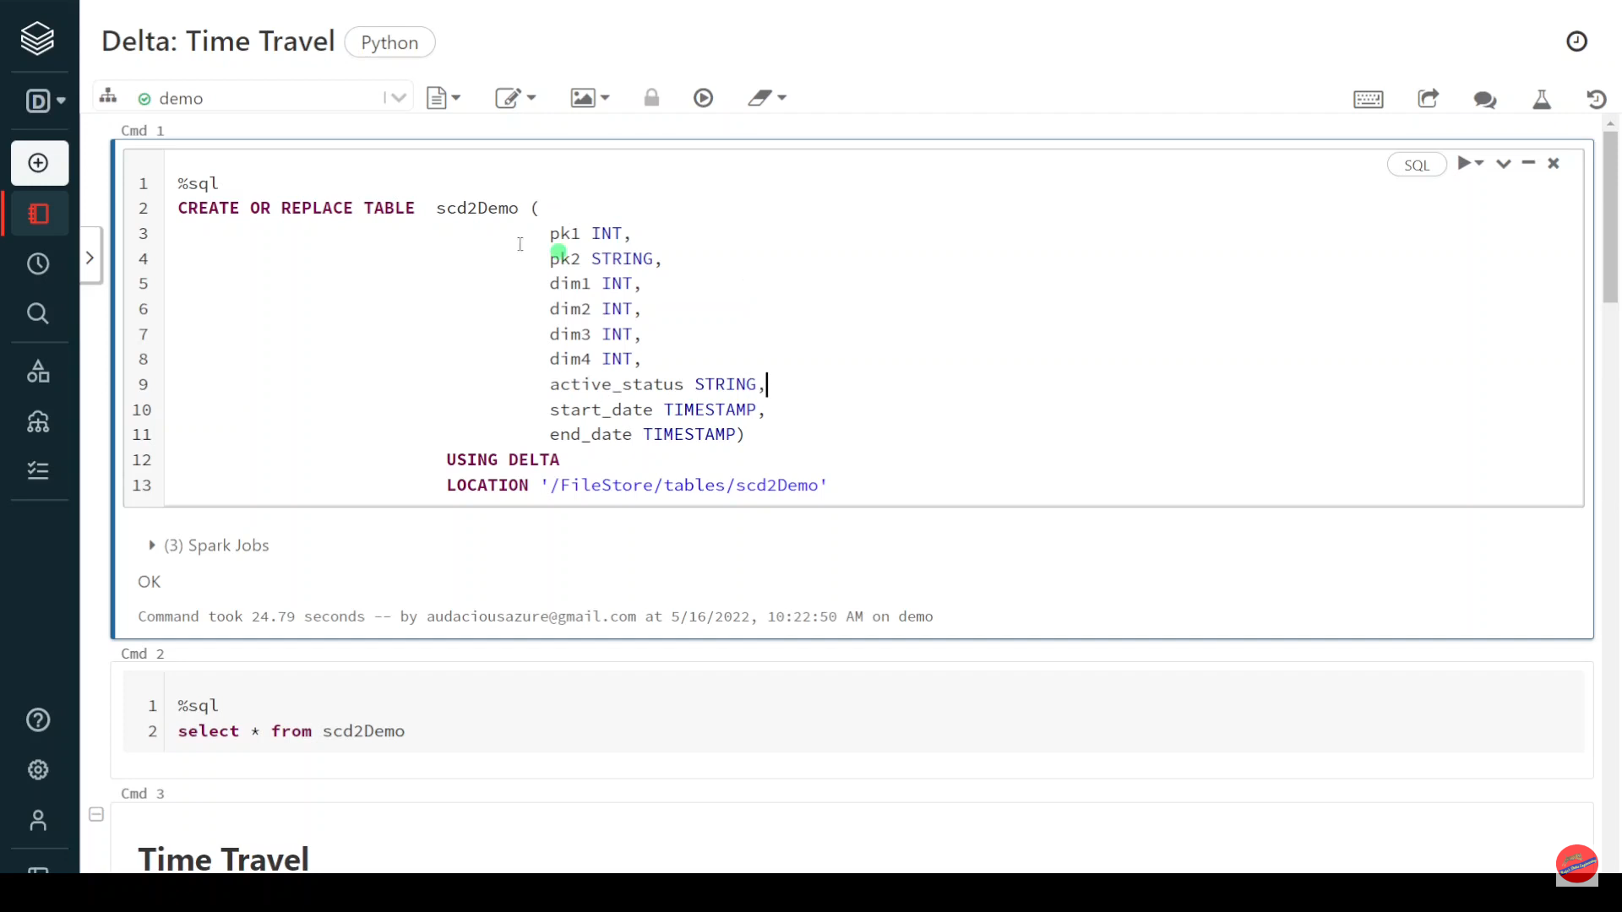
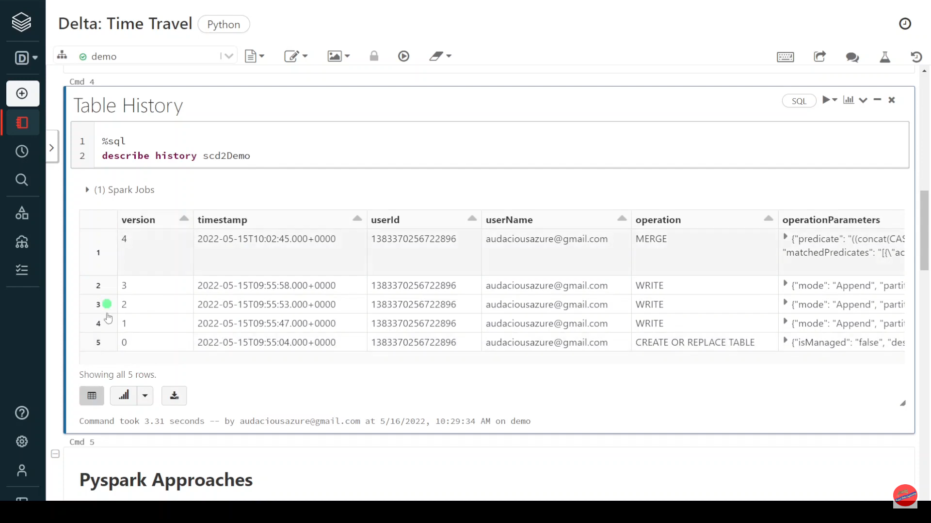

Slide 4
Pyspark Approaches
Method 1: Pyspark -Timestamp + Table
Method 2: Pyspark - Timestamp + Path
Method 3: Pyspark - version + Table
Method 4: Pyspark - version + Path
SQL Approaches
Method 1: SQL -Timestamp + Table
Method 2: SQL - Timestamp + Path
Method 3: SQL - version + Table
Method 4: SQL - version + Path

Slide 5
Pyspark| Delta Lake: Restore Command

Slide 6
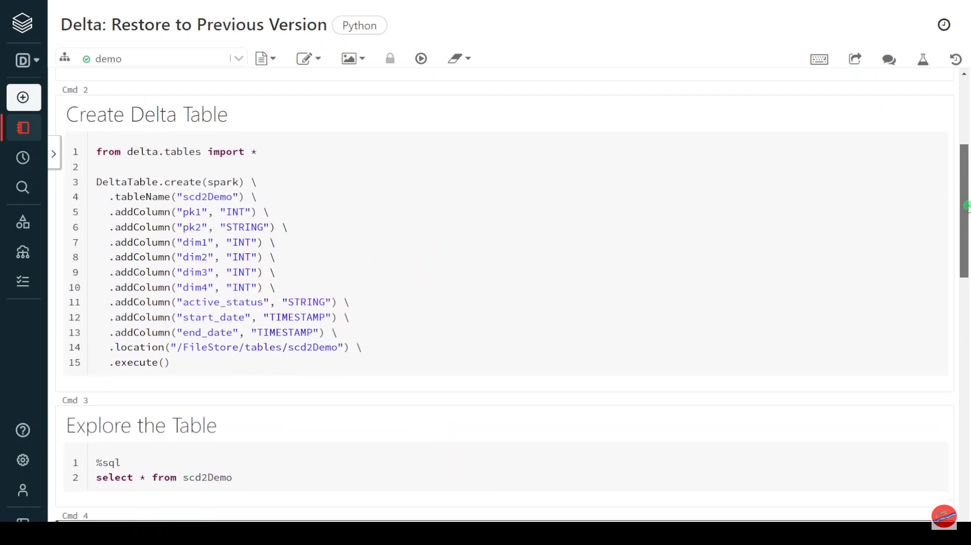

Slide 7
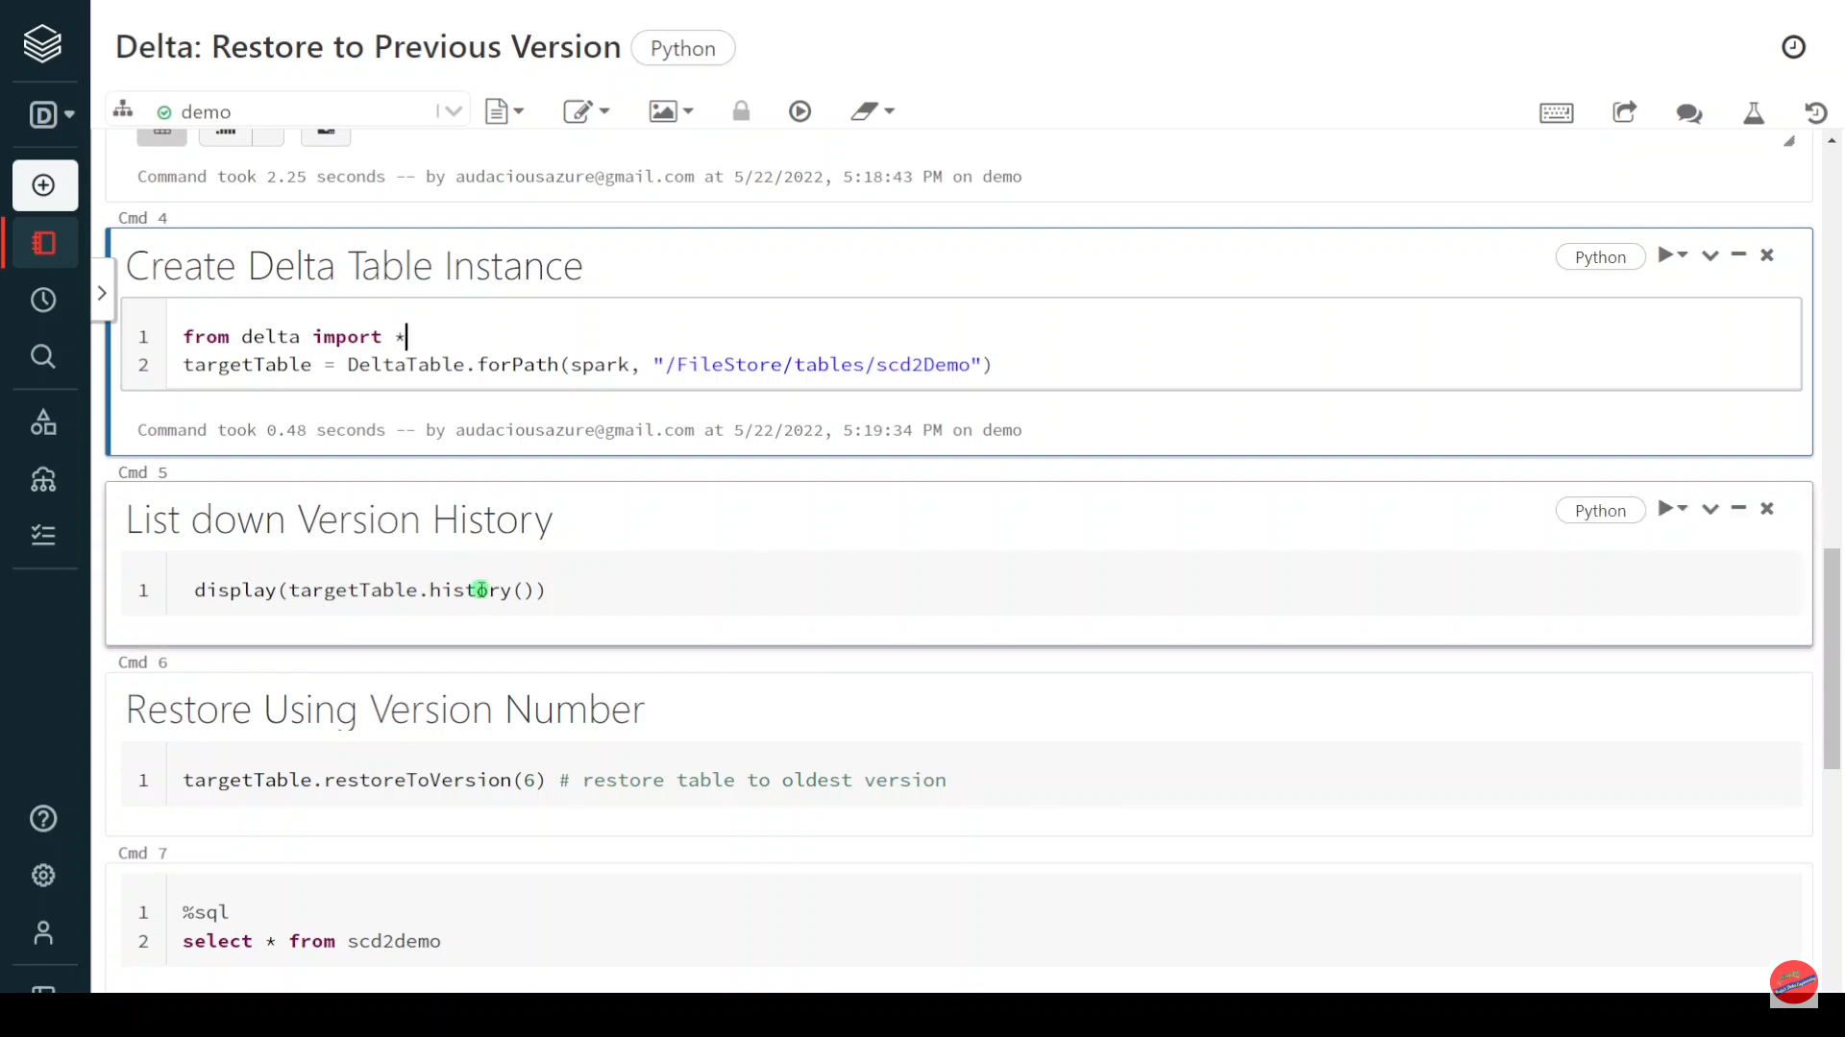

Slide 8
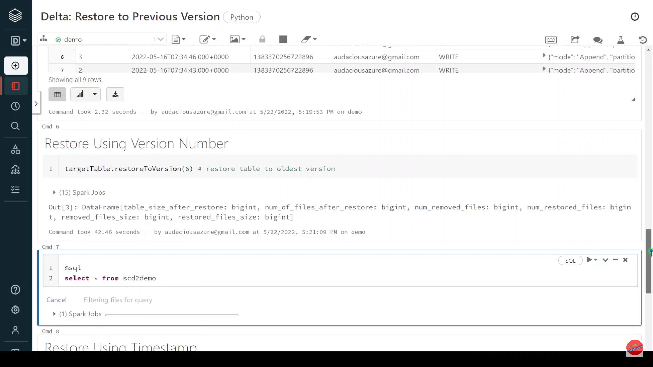

Slide 9
Delta Lake: Optimize Command - File Compaction

Slide 10
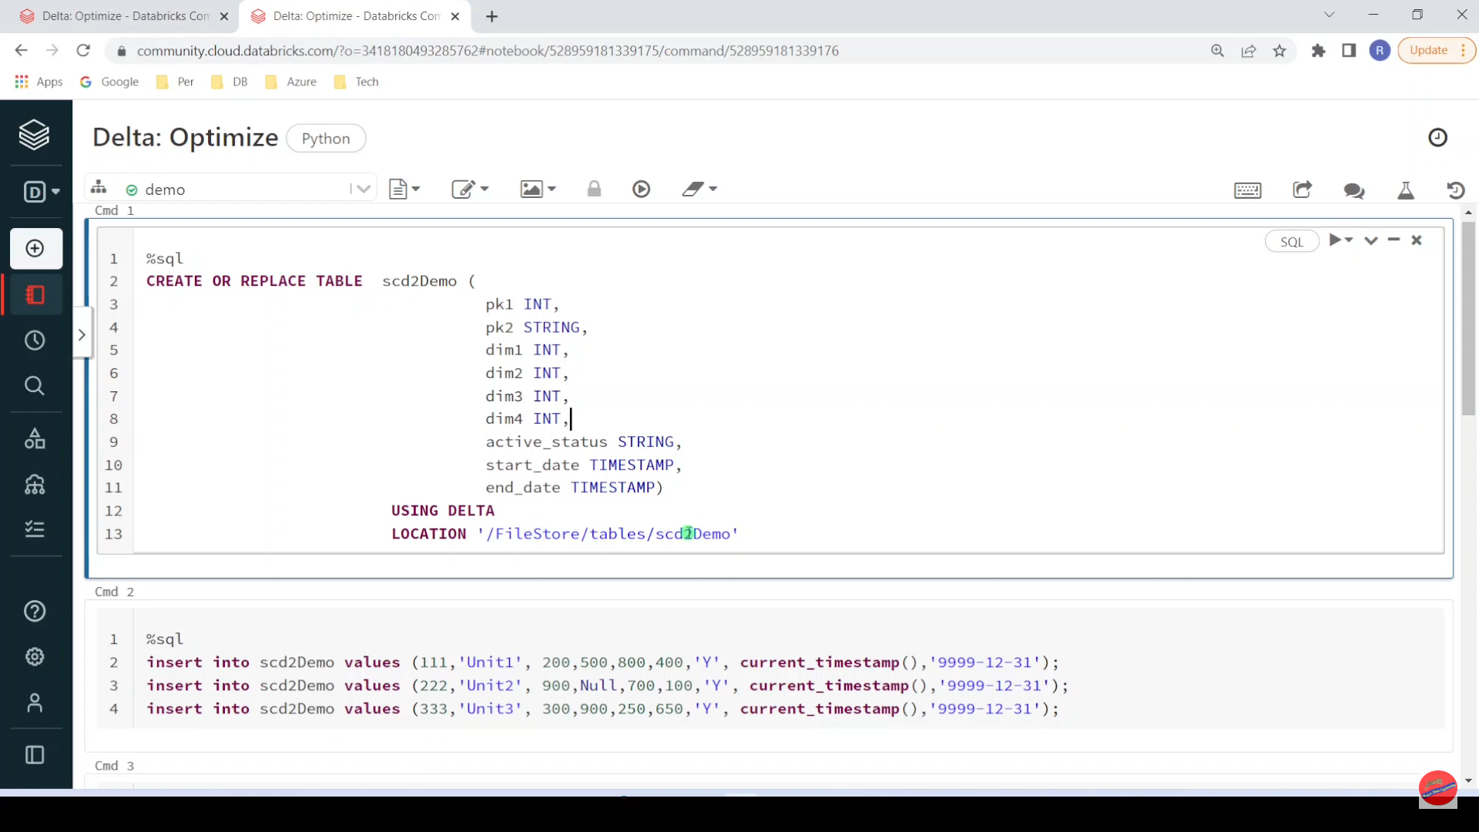

Slide 11
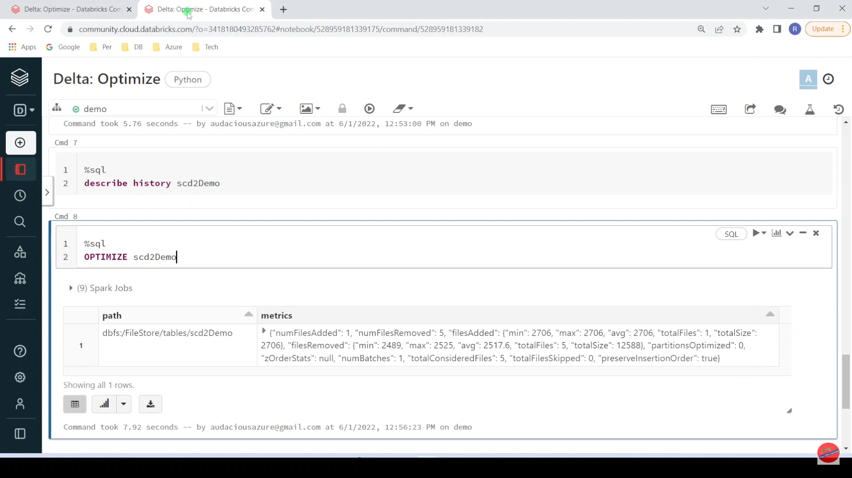

Slide 12
Pyspark | Delta Lake: Vacuum Command

Slide 13
Recursively vacuum directories associated with the Delta table. VACUUM removes all files from the table directory that are not managed by Delta, as well as data files that are no longer in the latest state of the transaction log for the table and are older than a retention threshold. VACUUM will skip all directories that begin with an underscore (_), which includes the _delta_log. Partitioning your table on a column that begins with an underscore is an exception to this rule; VACUUM scans all valid partitions included in the target Delta table. Delta table data files are deleted according to the time they have been logically removed from Delta’s transaction log plus retention hours, not their modification timestamps on the storage system. The default threshold is 7 days.
On Delta tables, Azure Databricks does not automatically trigger VACUUM operations.
If you run VACUUM on a Delta table, you lose the ability to time travel back to a version older than the specified data retention period.
Syntax:
VACUUM <table_name> [RETAIN <num_versions>] [HOURS <num_hours]];

Slide 14
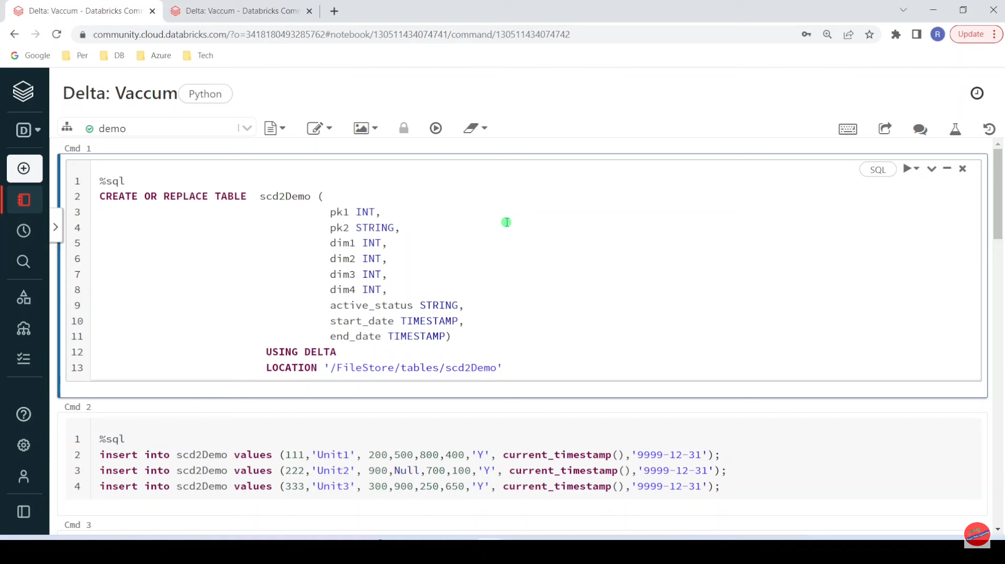

Slide 15
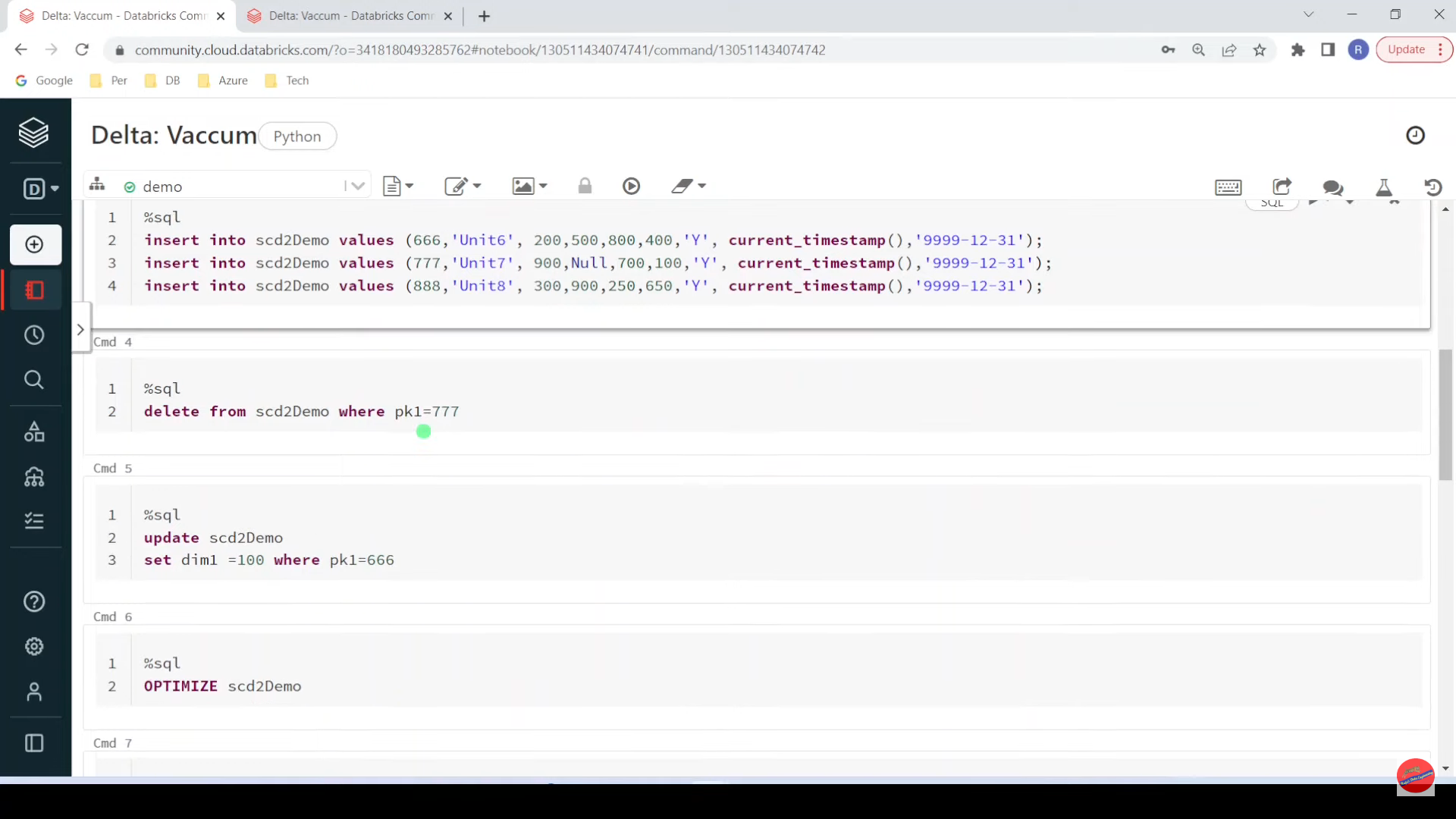

Slide 16
auto loader vs incremental load data-bricks

Slide 17
Auto Loader:
Auto Loader is a feature provided by Databricks to simplify the process of ingesting data from sources such as Delta tables, Apache Kafka, or Azure Event Hubs.
It automatically manages and optimizes the loading of new data into a Delta table, without requiring manual intervention.
Auto Loader can efficiently process new data in real-time, making it suitable for scenarios where you need to keep your data up-to-date continuously.
It helps in avoiding duplicate data loads and ensures that only the new or modified data is processed.
Incremental Load:
Incremental loading is a strategy where only the new or modified data since the last data load is processed and loaded into the target data store.
This approach is typically used to reduce the processing time and resource requirements when dealing with large datasets.
In an incremental load scenario, you need to track the changes in the source data and load only the delta (changes) into the destination system.
Incremental loading can be implemented using various techniques, such as timestamp-based filtering or change data capture (CDC).

Slide 18
Comparison:
Automation:
Auto Loader is more automated and handles the tracking of changes internally, simplifying the process for the user.
Incremental loading often requires explicit mechanisms to track changes in the source data, which may involve additional scripting or configuration.
Real-time vs. Batch:
Auto Loader is designed for real-time or near-real-time data ingestion, making it suitable for scenarios where you need continuous updates.
Incremental loading can be implemented in both real-time and batch processing, depending on the chosen strategy and tools.
Ease of Use:
Auto Loader is designed to be user-friendly and requires minimal manual intervention.
Incremental loading may require more effort to set up and maintain, as users need to implement mechanisms to identify and load only the changed data.

Slide 19
Pyspark | Delta: Z-Order Command

Slide 20
Z-ordering is a technique to colocate related information in the same set of files. This co-locality is automatically used by Delta Lake on Databricks data-skipping algorithms. This behavior dramatically reduces the amount of data that Delta Lake on Databricks needs to read. To Z-order data, you specify the columns to order on in the ZORDER BY clause:

Slide 21
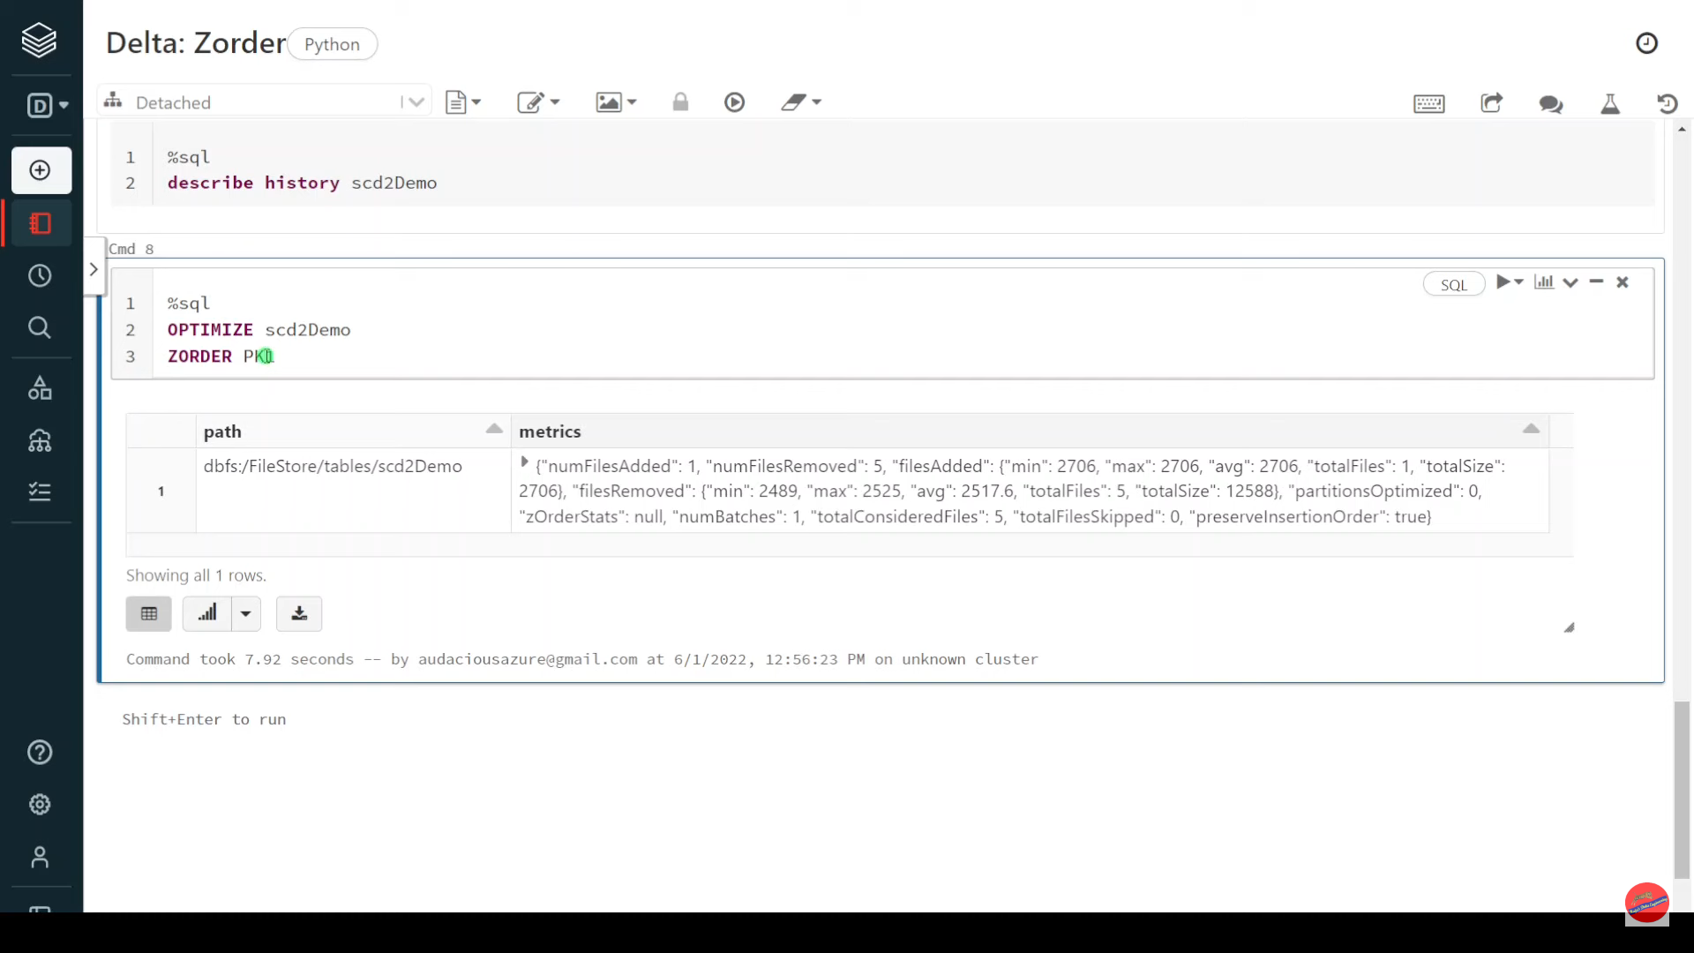

Slide 22
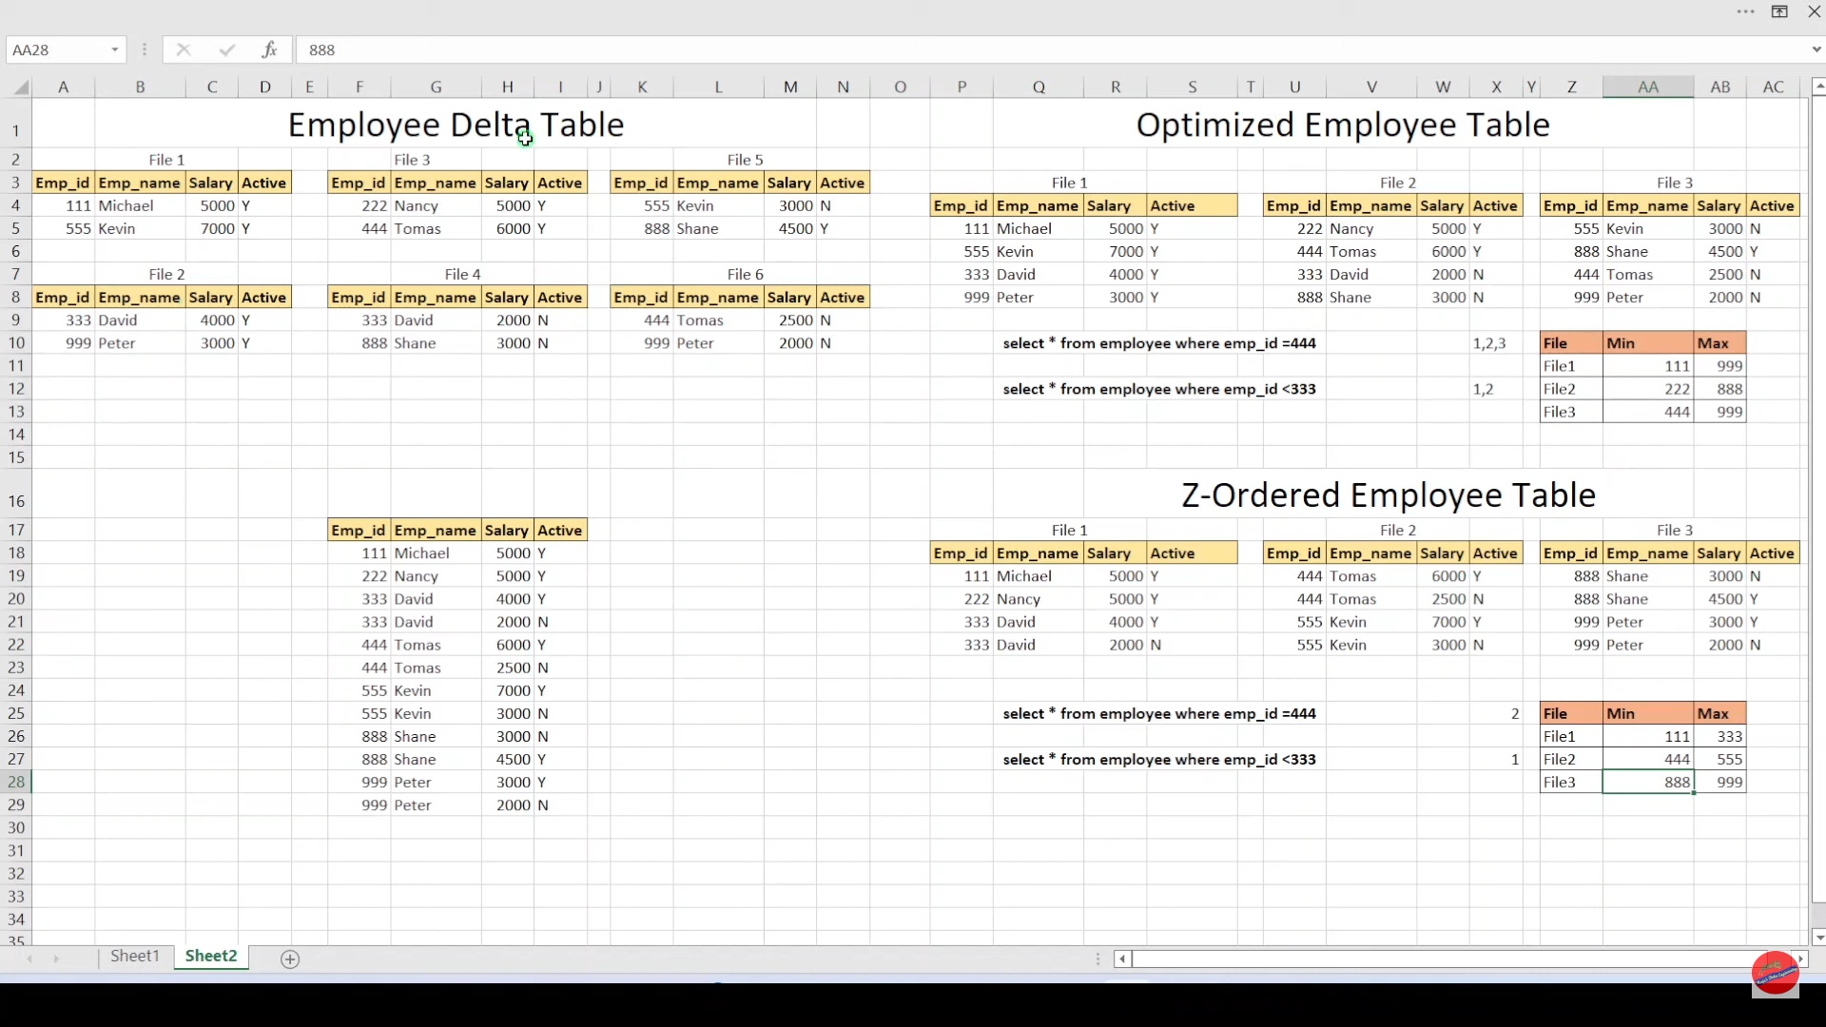

Slide 23
Pypark | Delta: Schema Evolution - MergeSchema

Slide 24
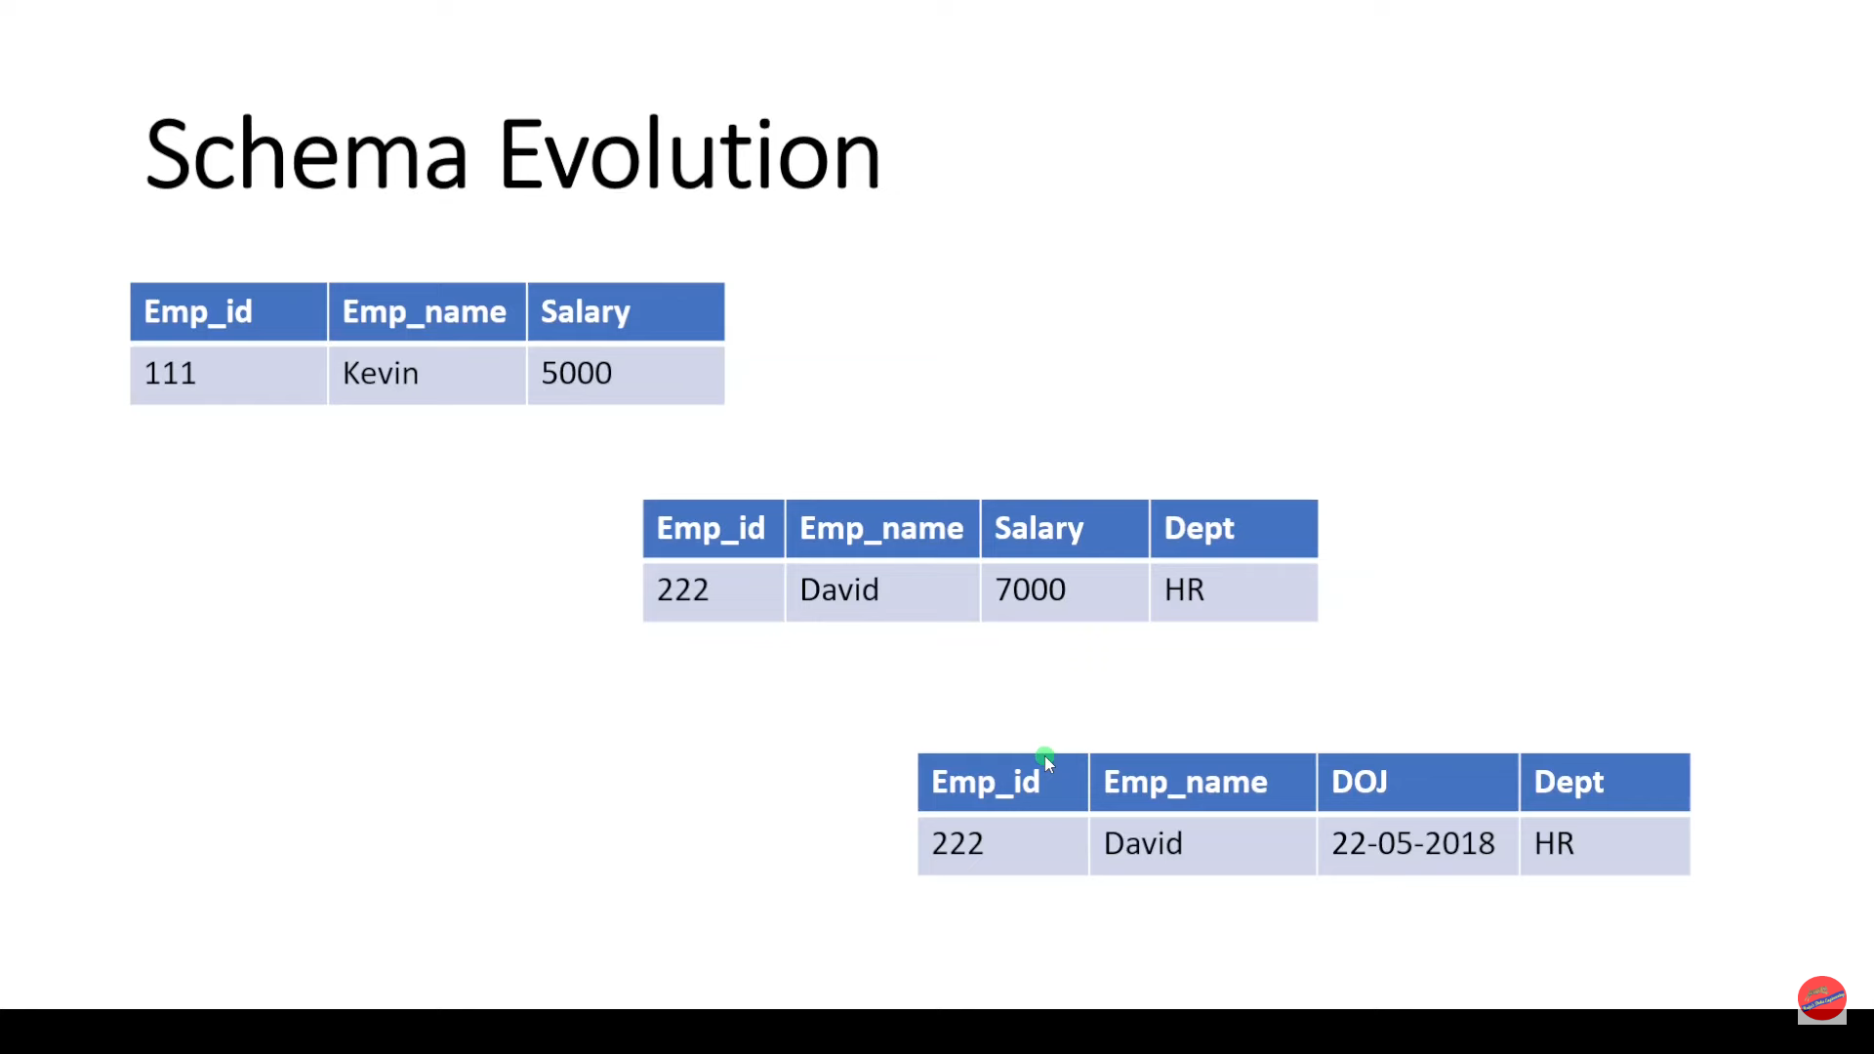

Slide 25
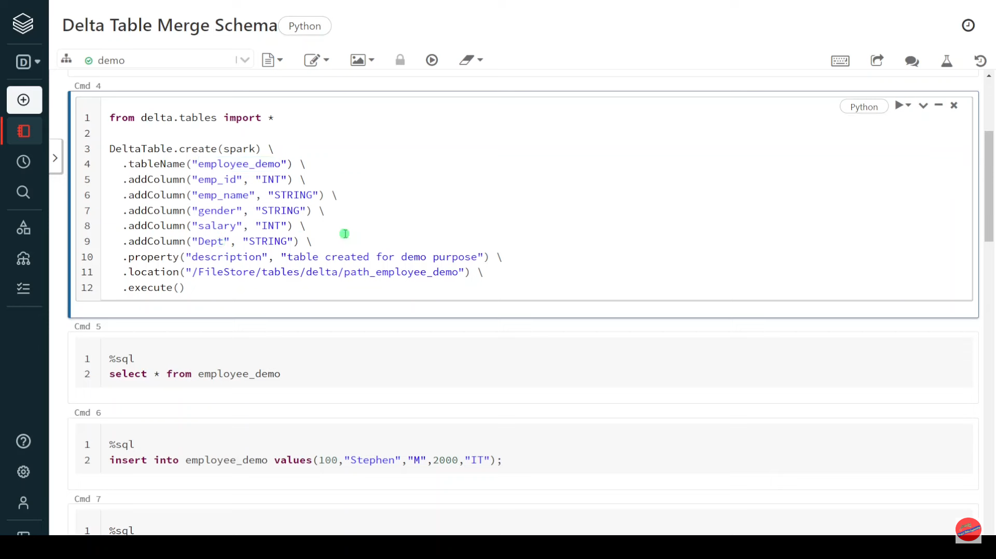

Slide 26
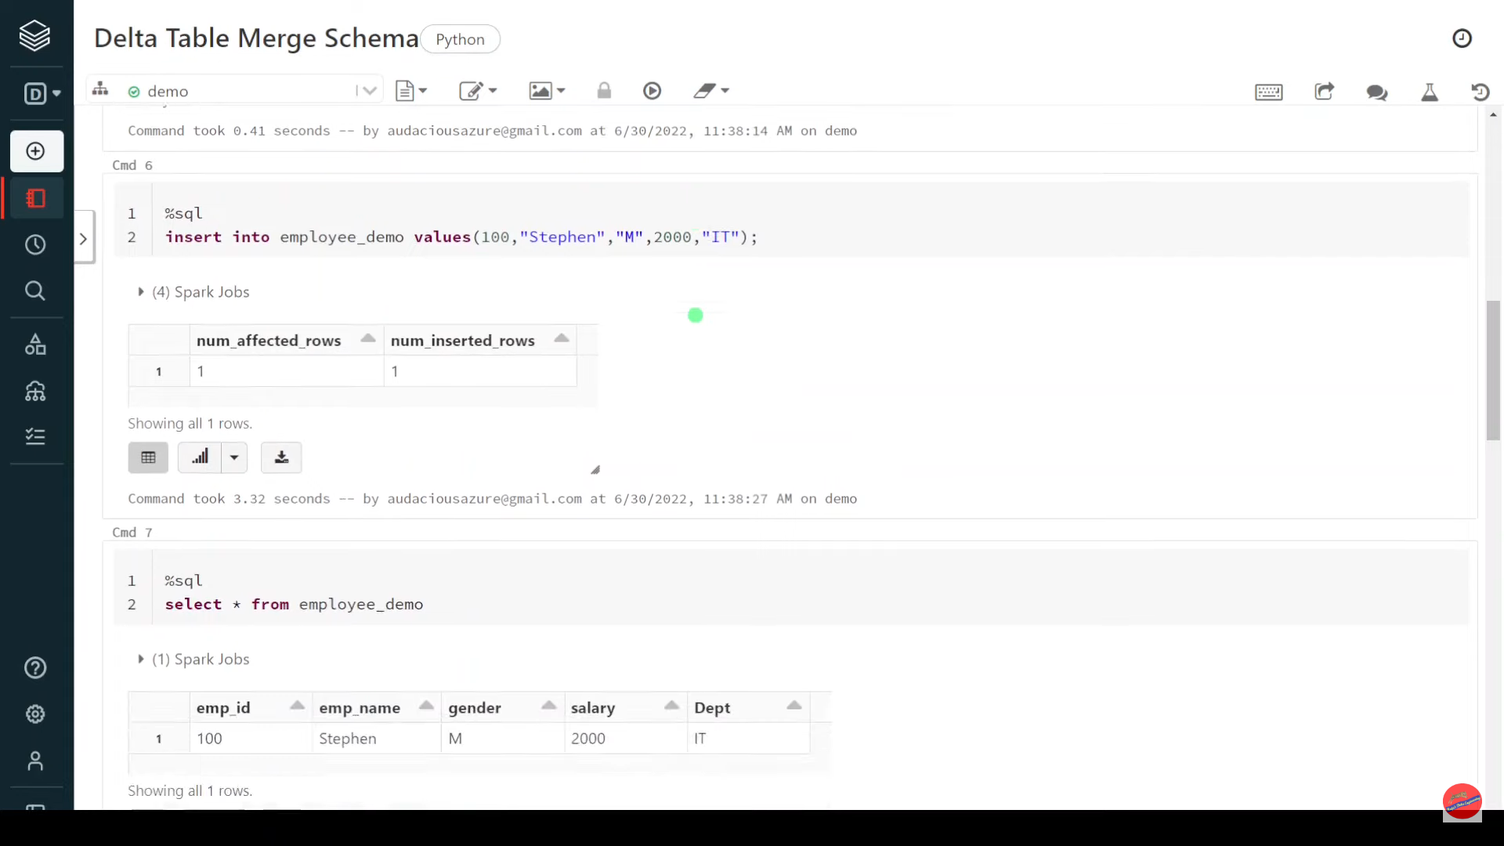

Slide 27
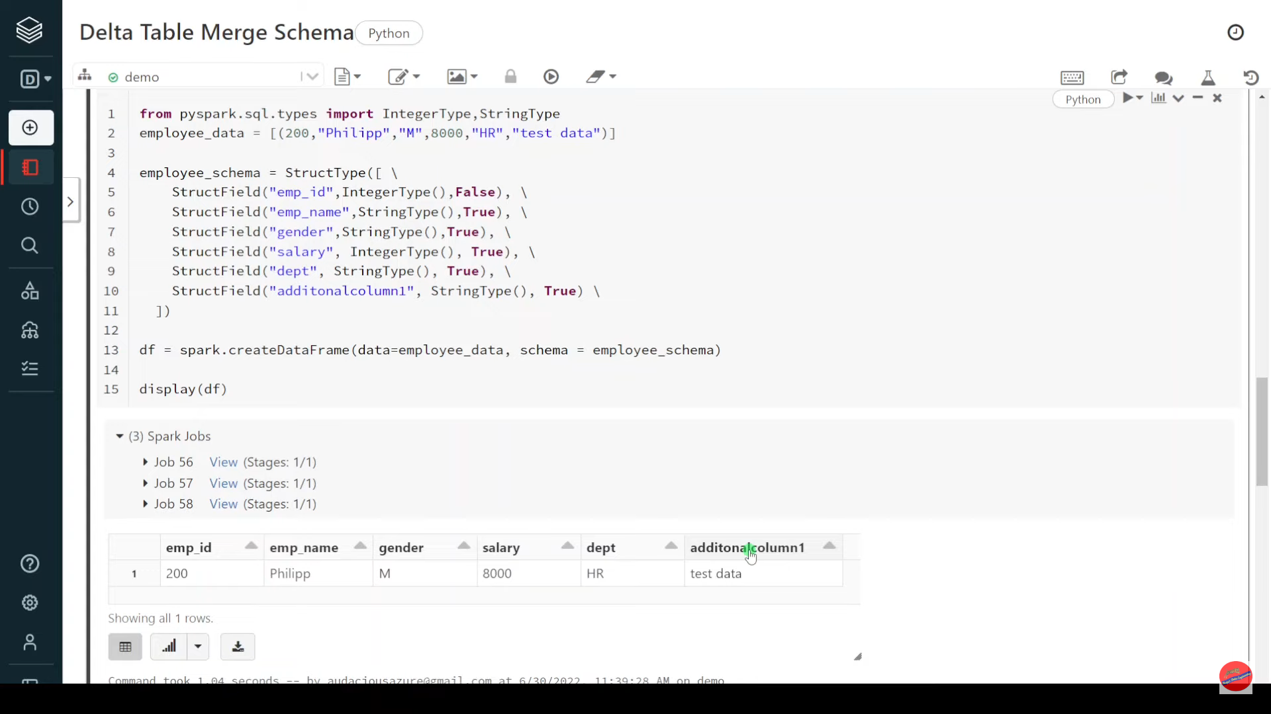

Slide 28
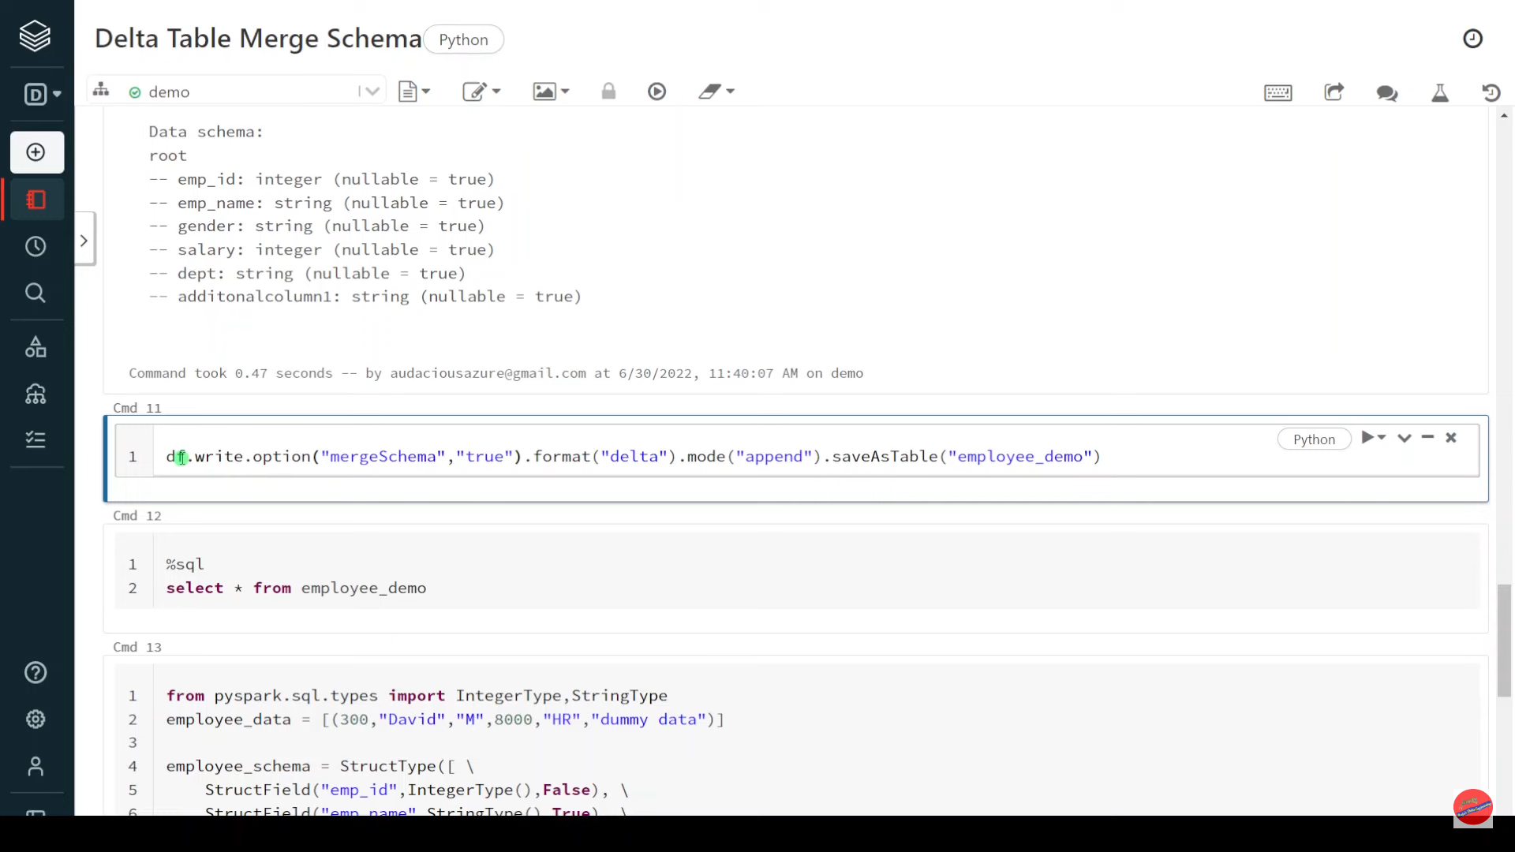

Slide 29
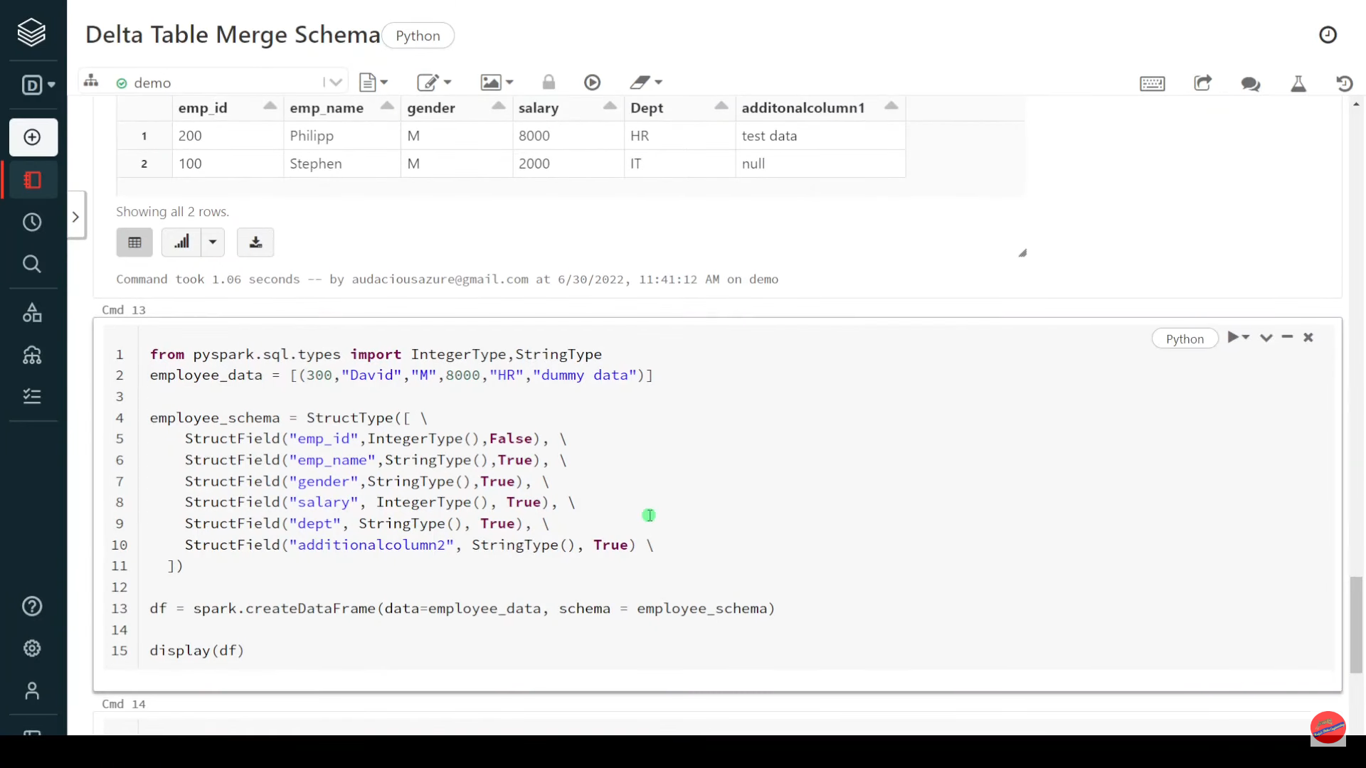

Slide 30
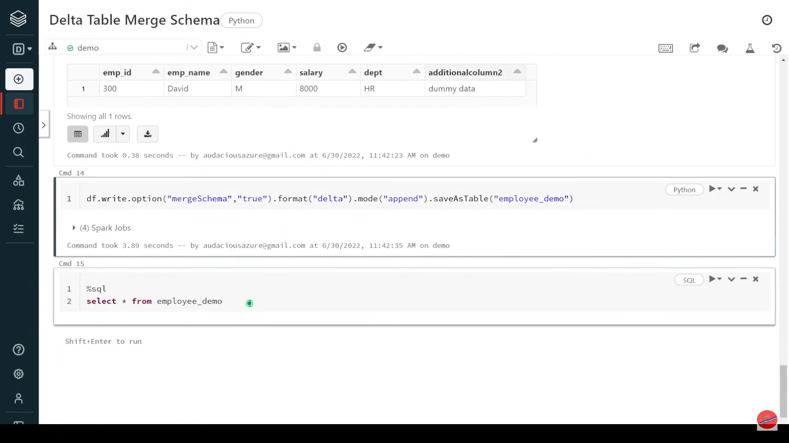

Slide 31
Pyspark | Dataframe InsertInto Delta Table

Slide 32
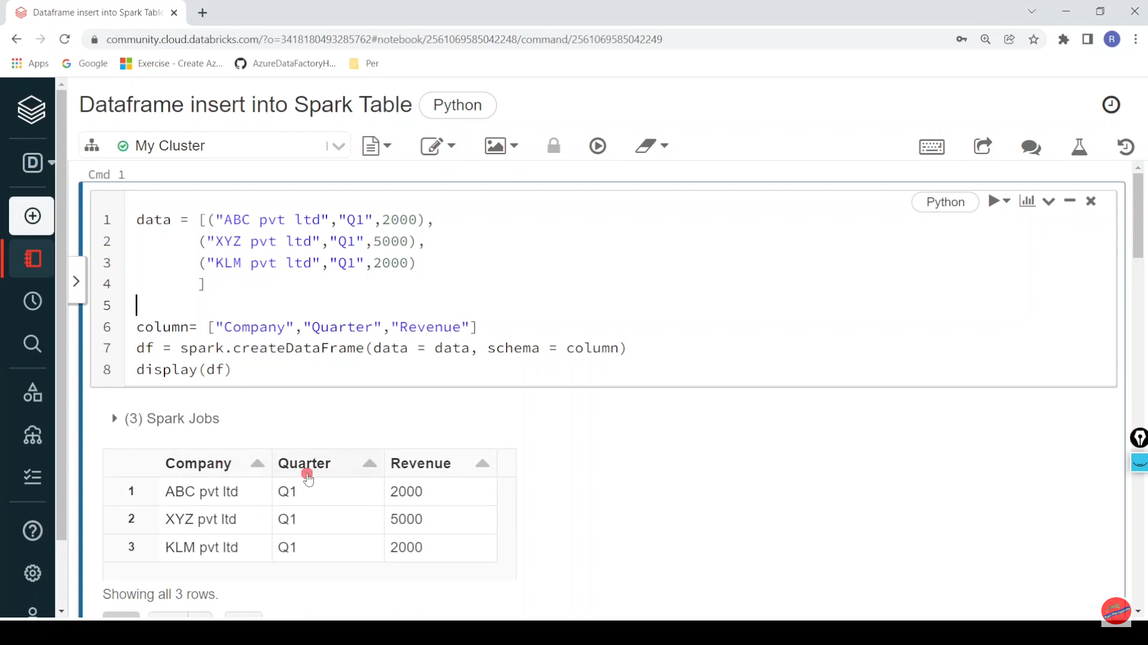

Slide 33
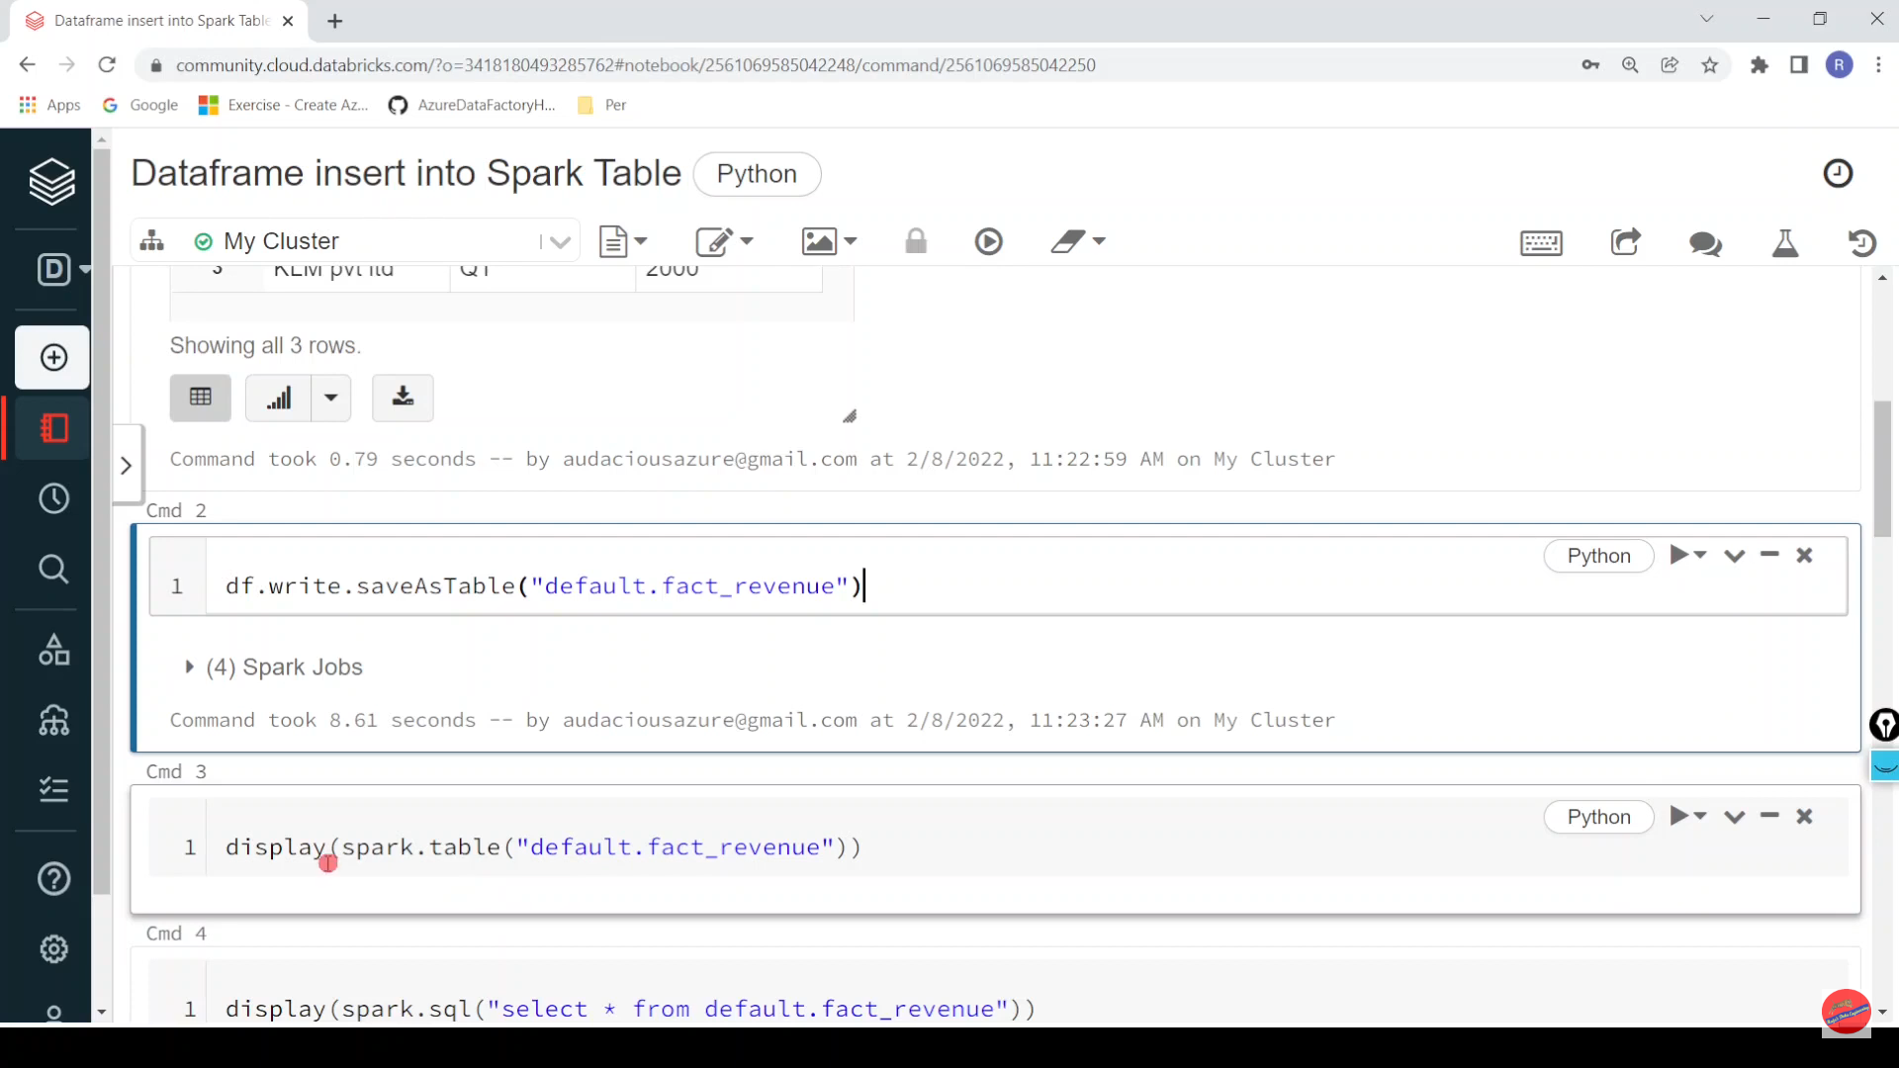

Slide 34
Pyspark | Data Skewness| Interview Question: SPARK_PARTITION_ID

Slide 35
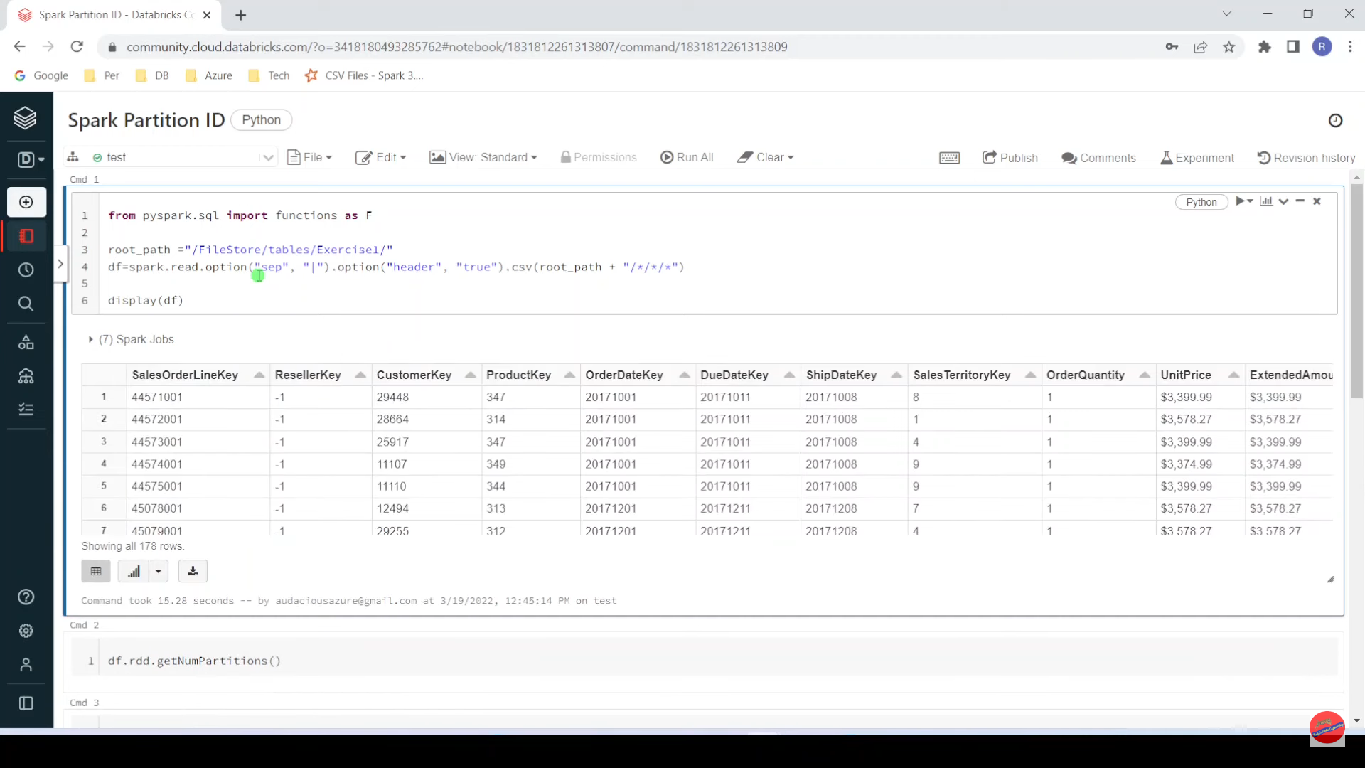

Slide 36
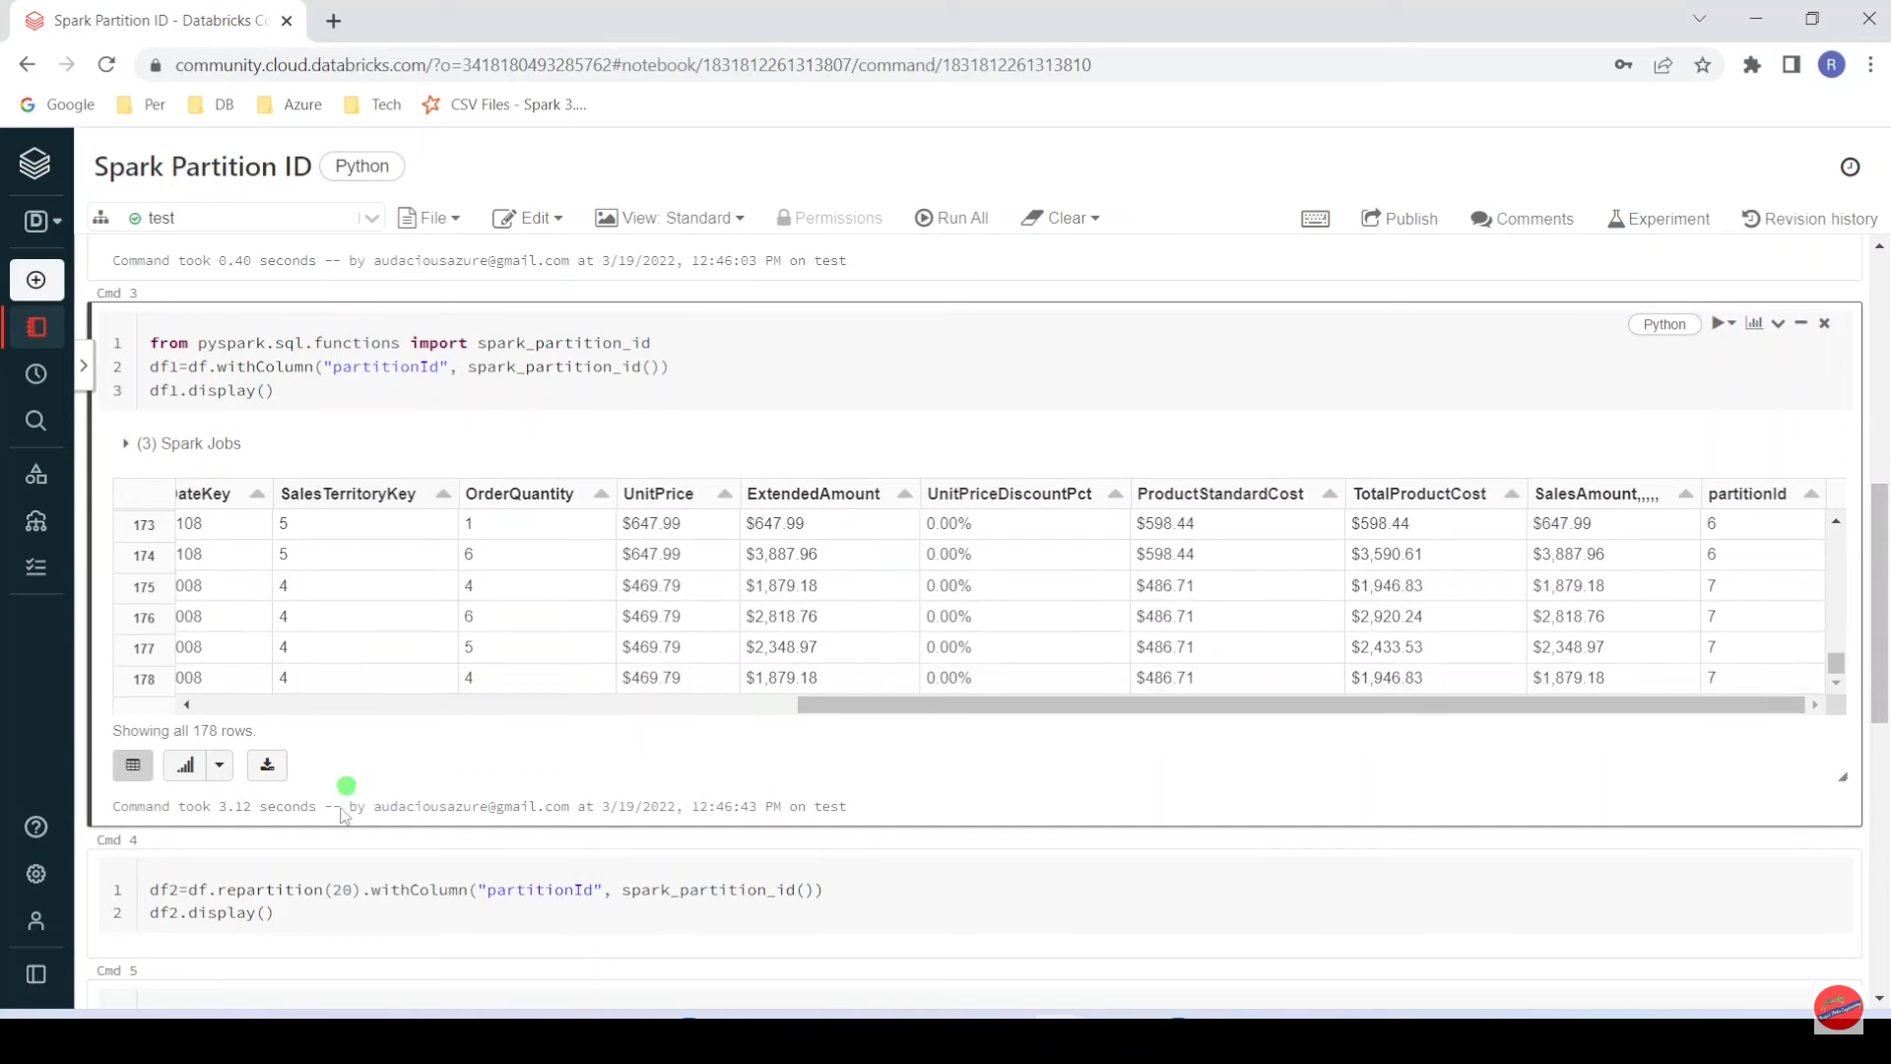

Slide 37
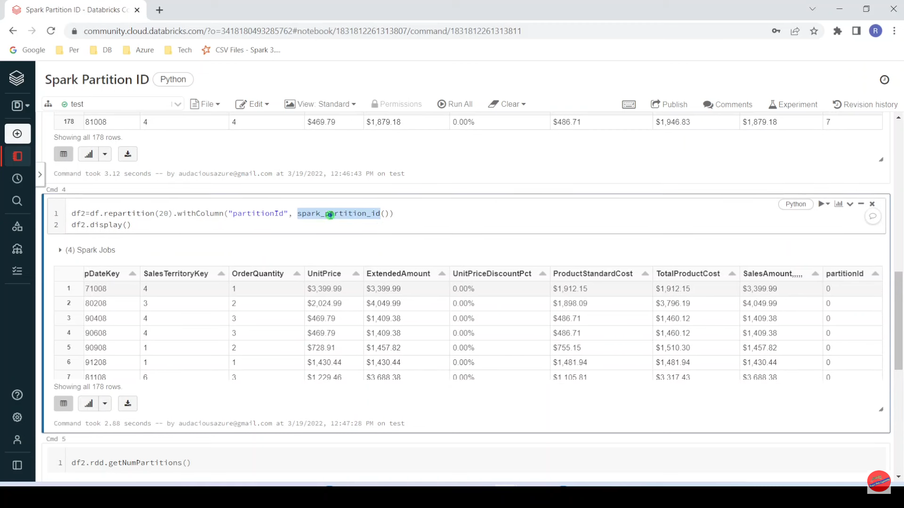

Slide 38


Slide 39
Pyspark| Input_File_Name: Identify Input File Name of Corrupt Record

Slide 40
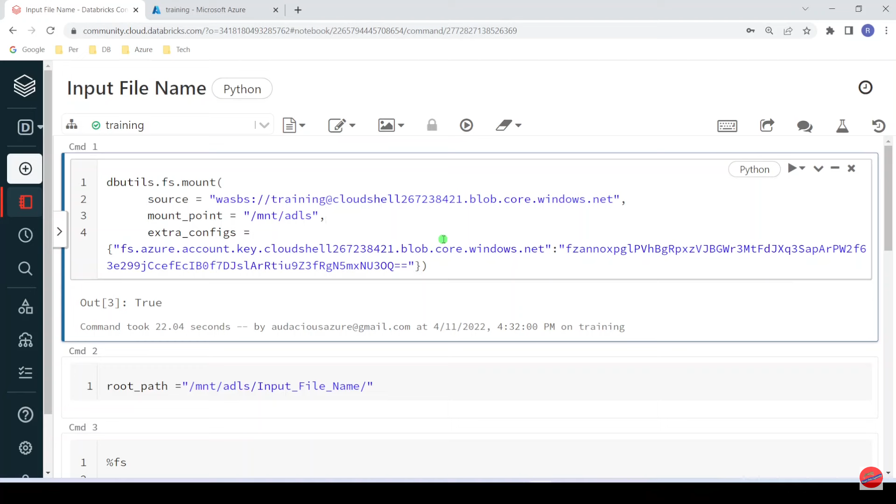

Slide 41
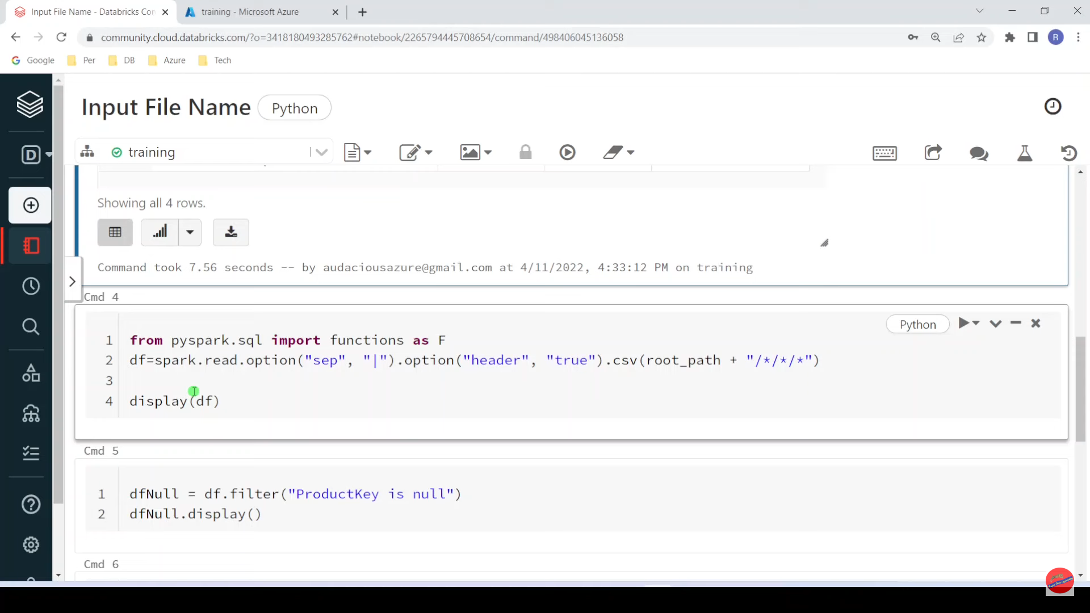

Slide 42
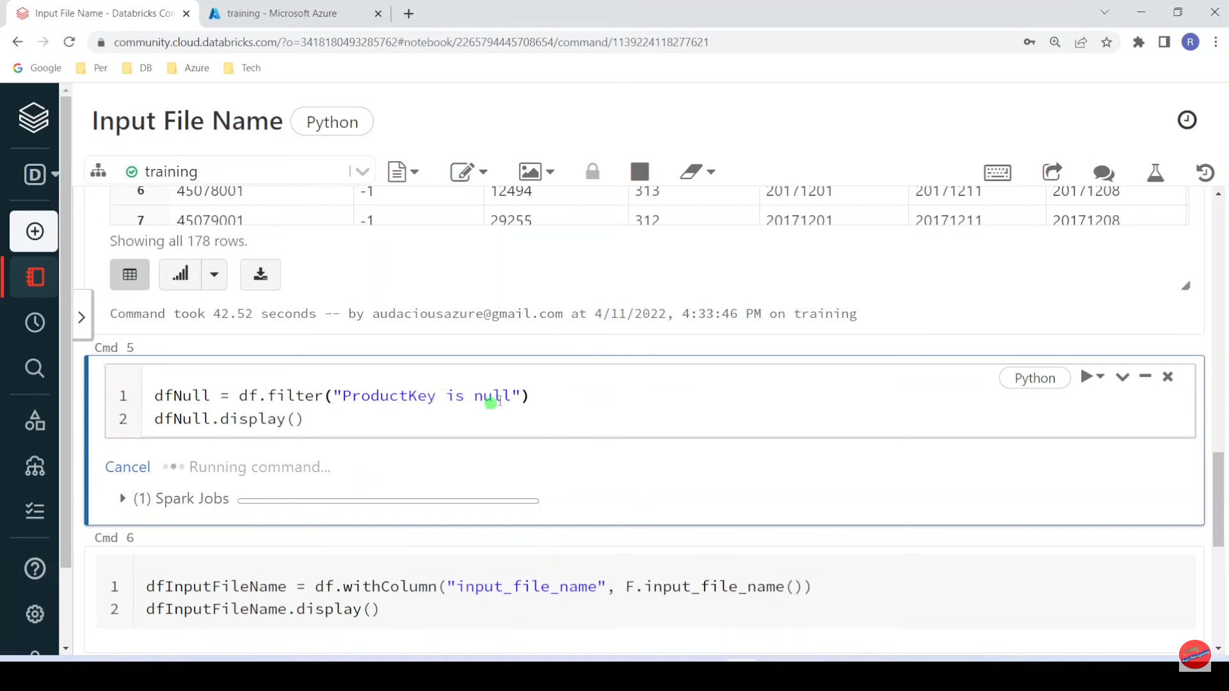

Slide 43
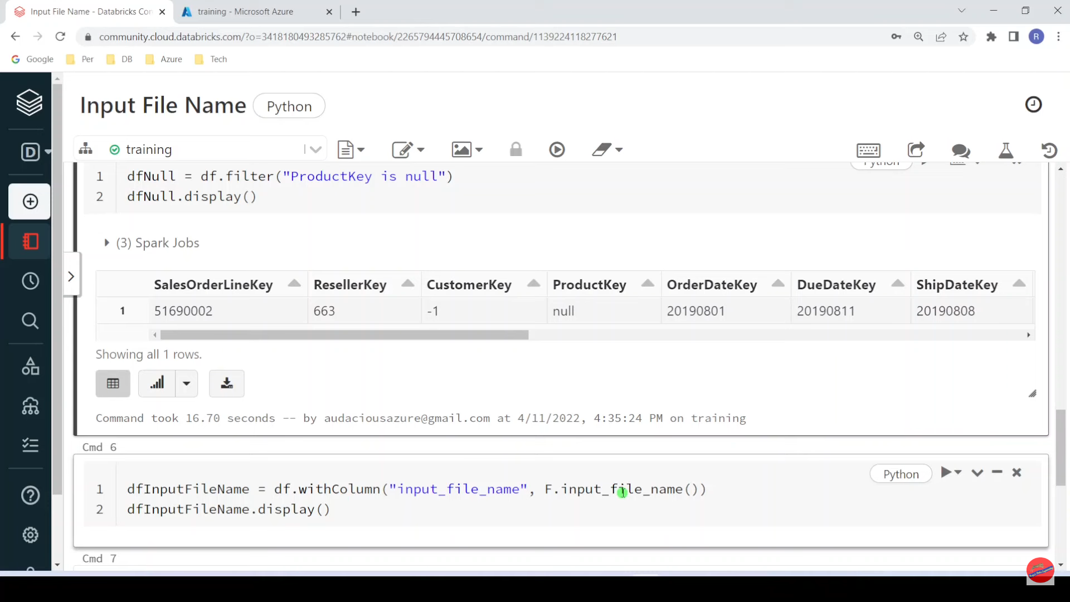

Slide 44
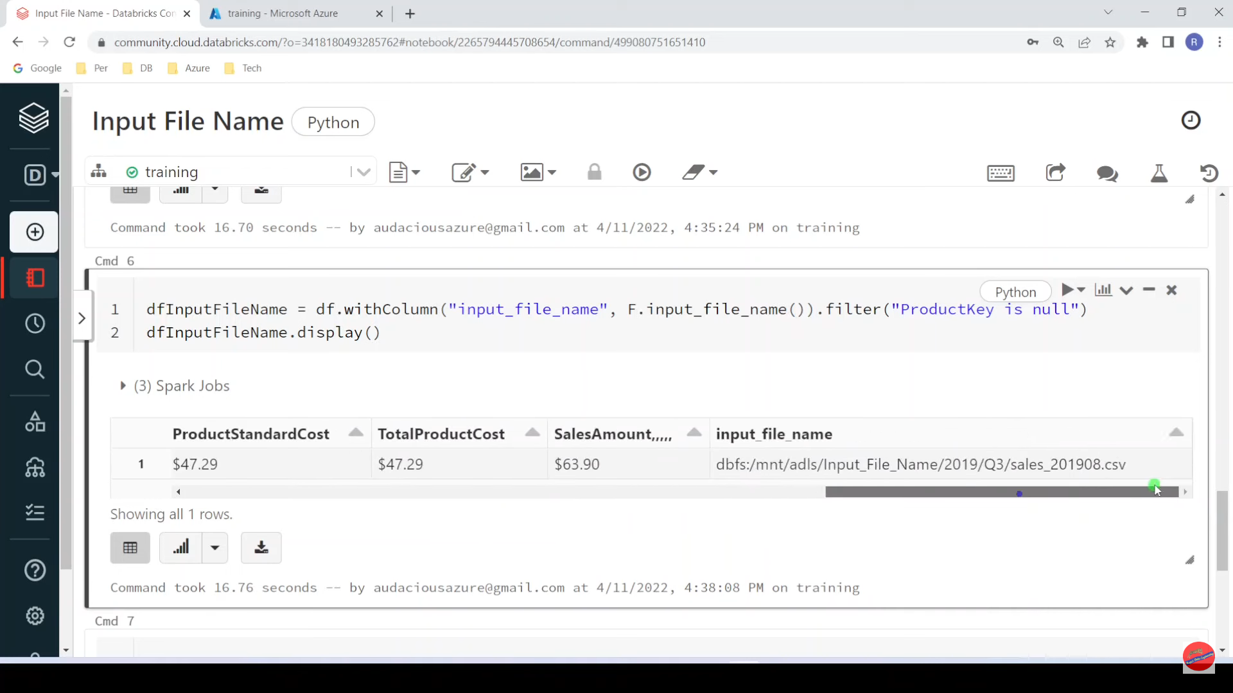

Slide 45
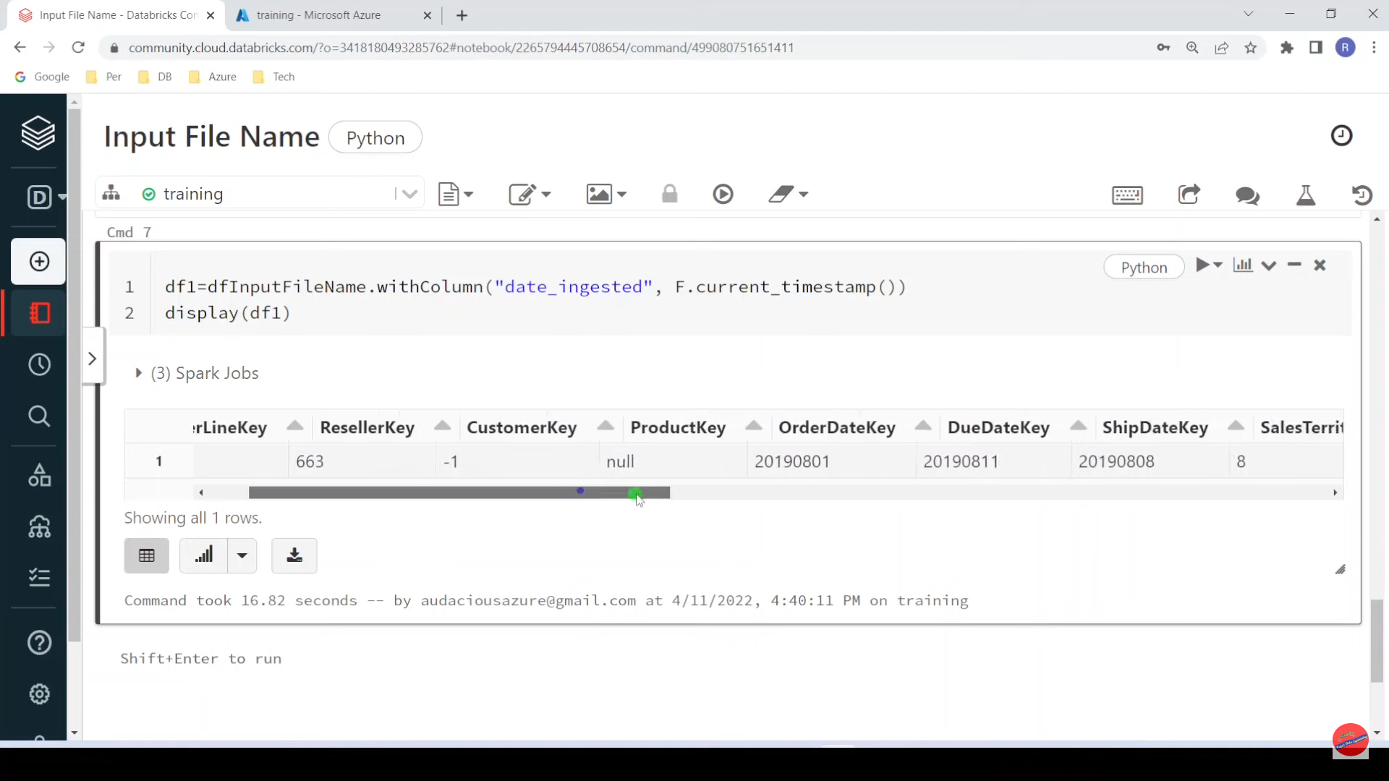

Slide 46
Pyspark | Window Functions: Lead and Lag

Slide 47
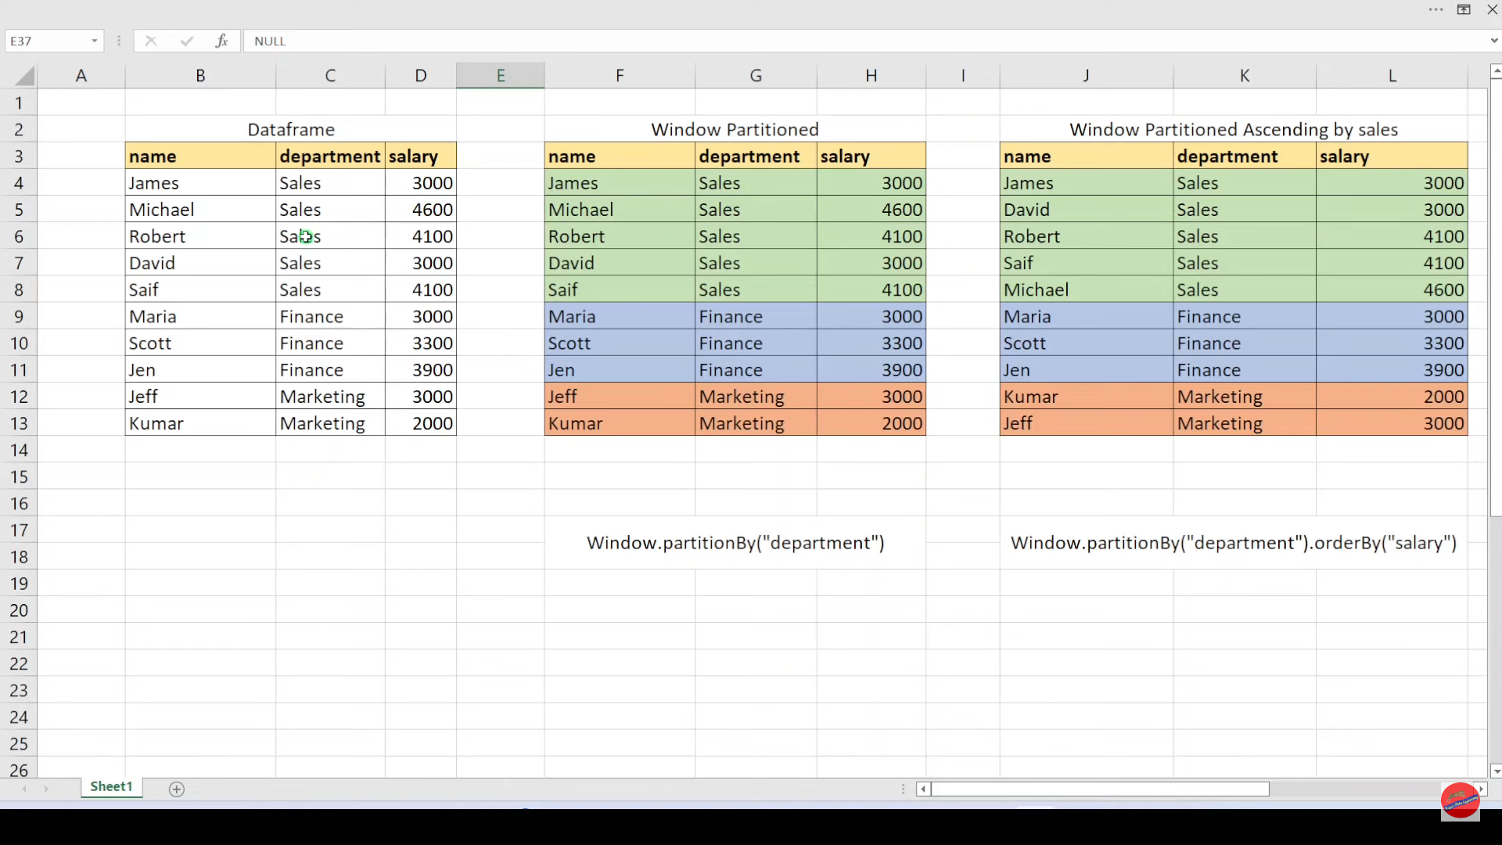

Slide 48
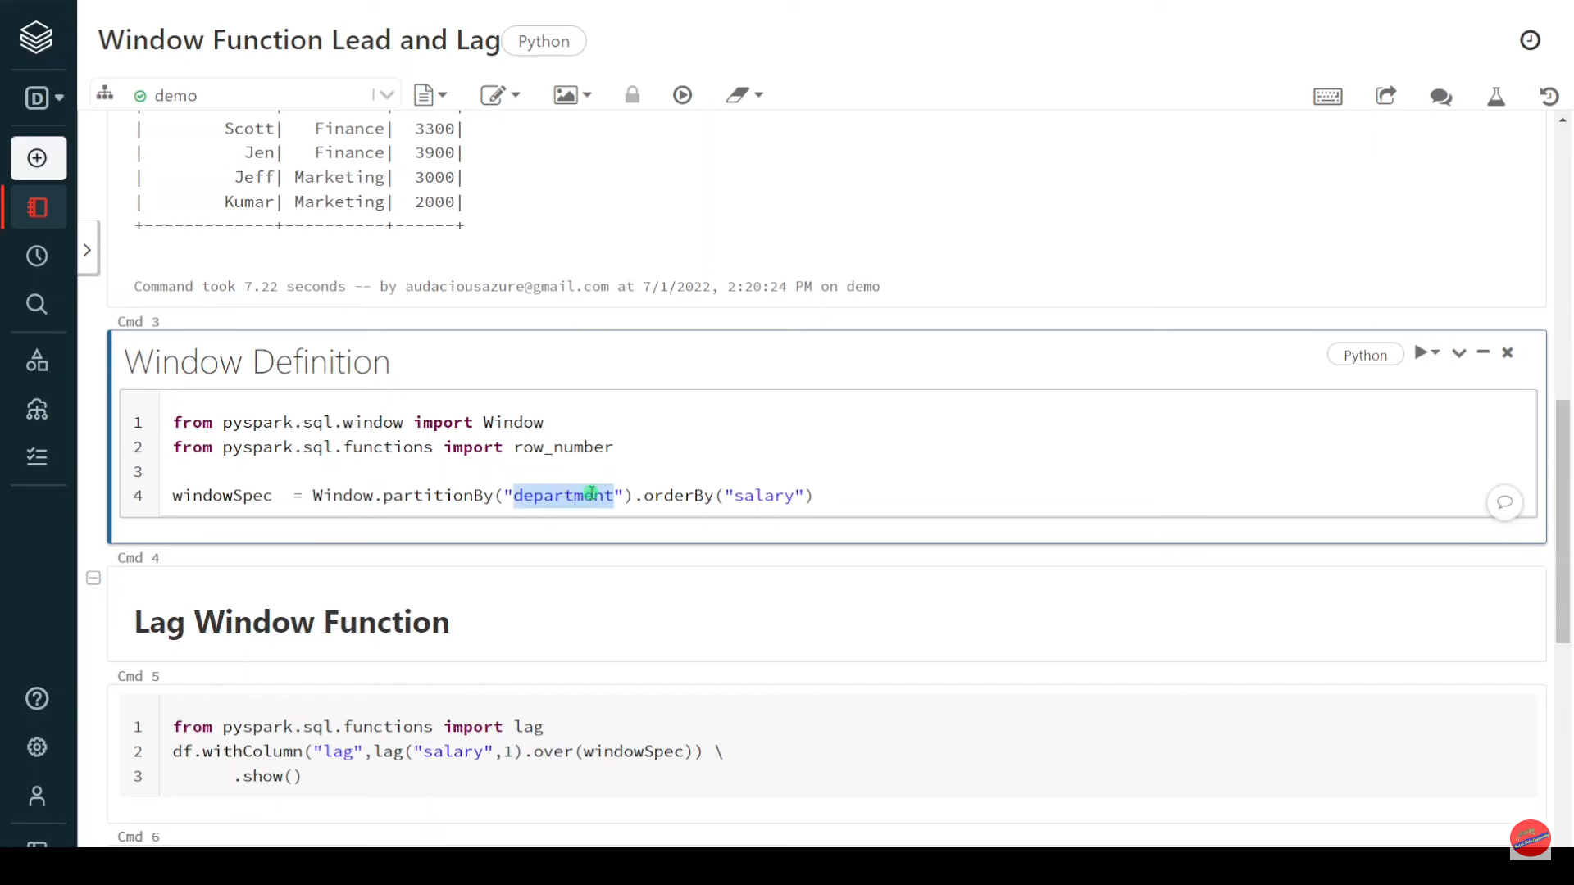

Slide 49
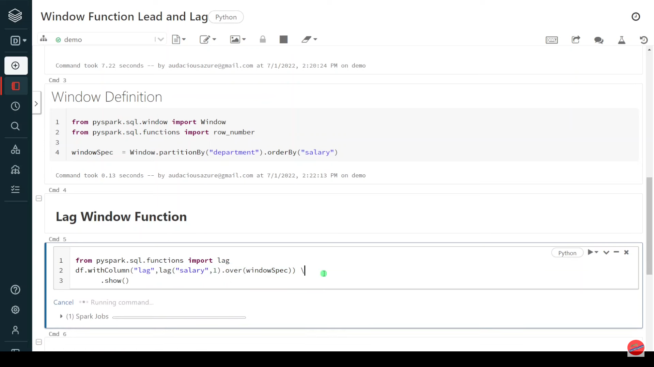

Slide 50
Pyspark | Interview Question: Explain Plan

Slide 51
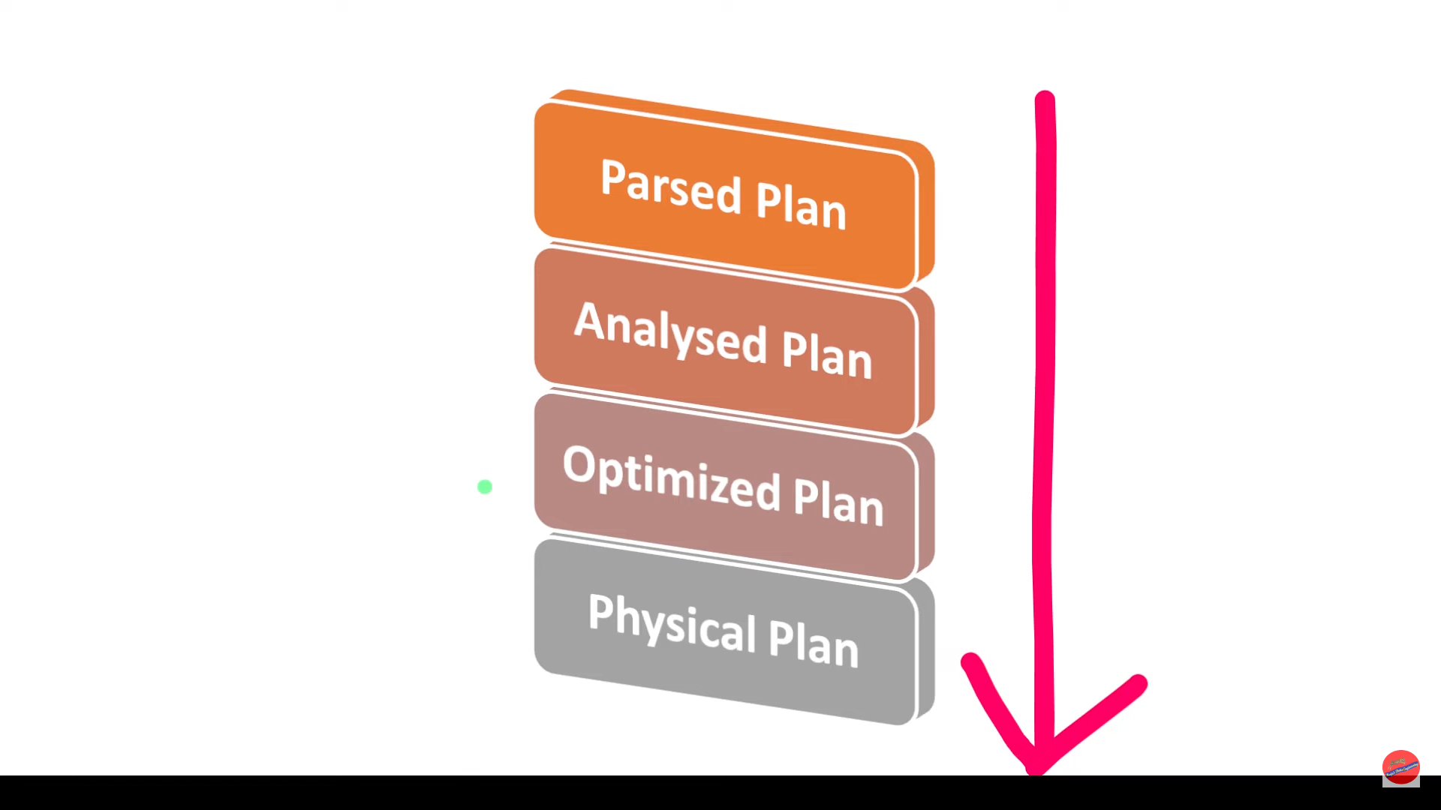

Slide 52
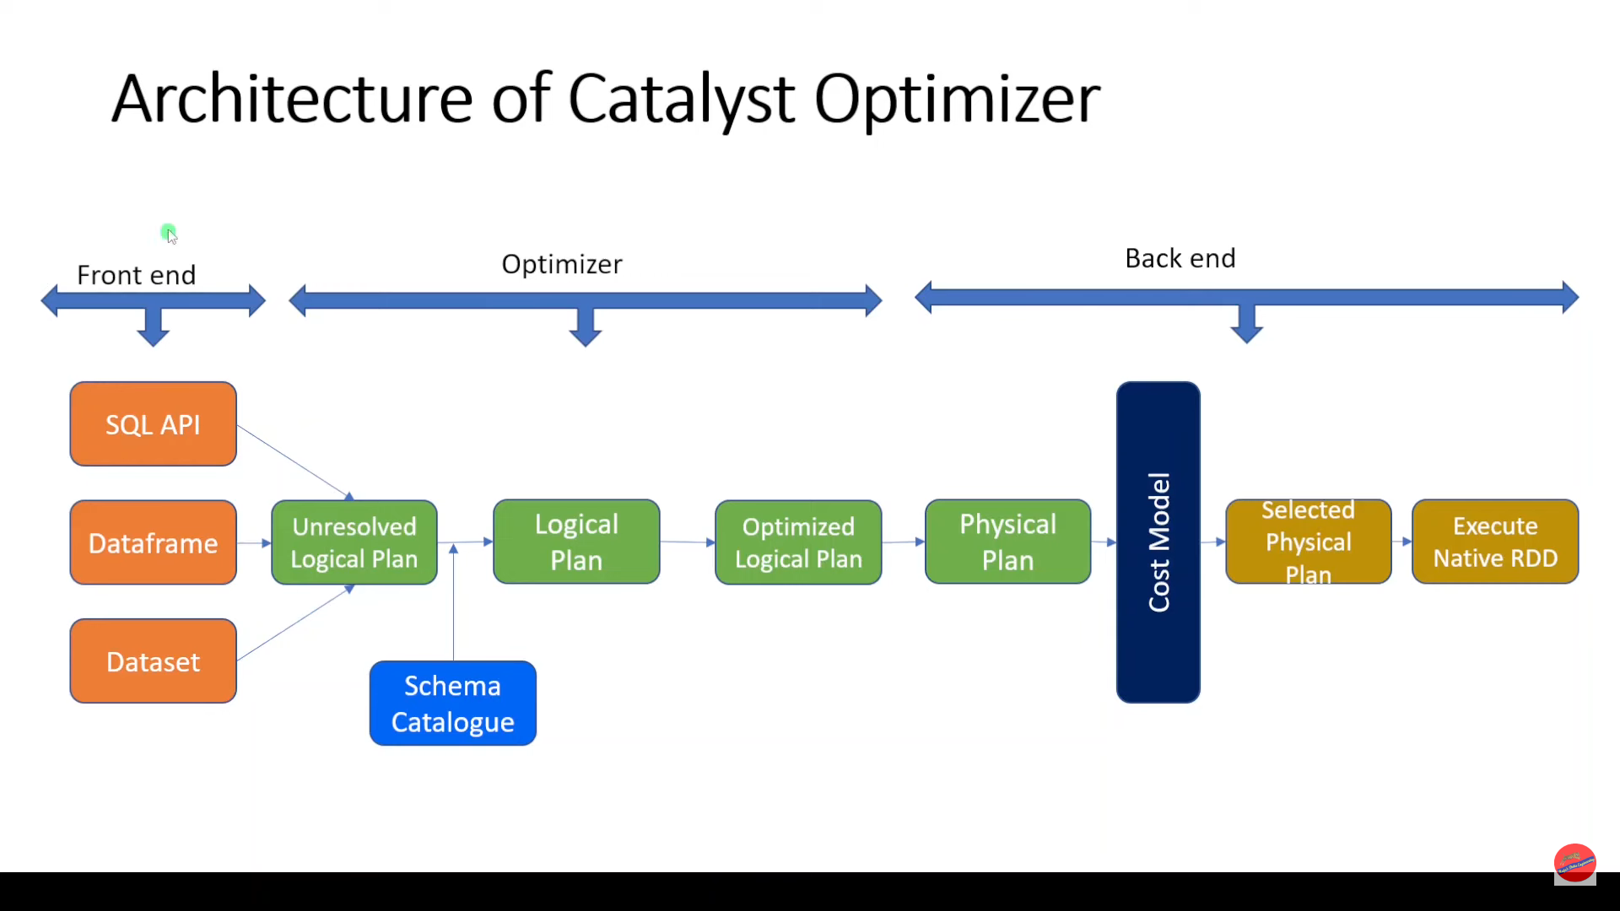

Slide 53
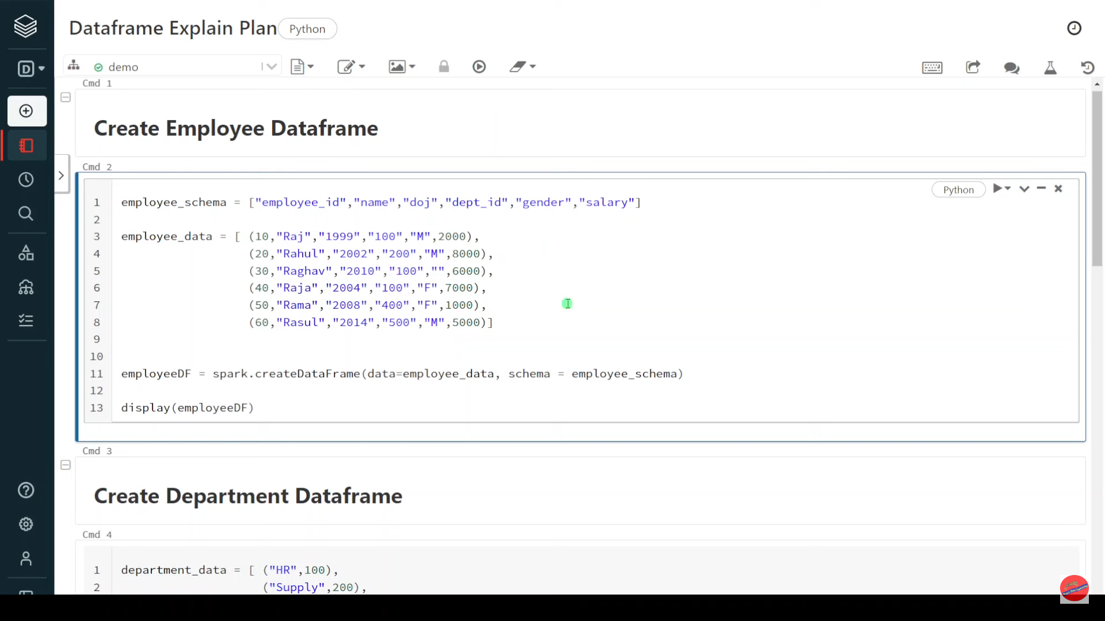
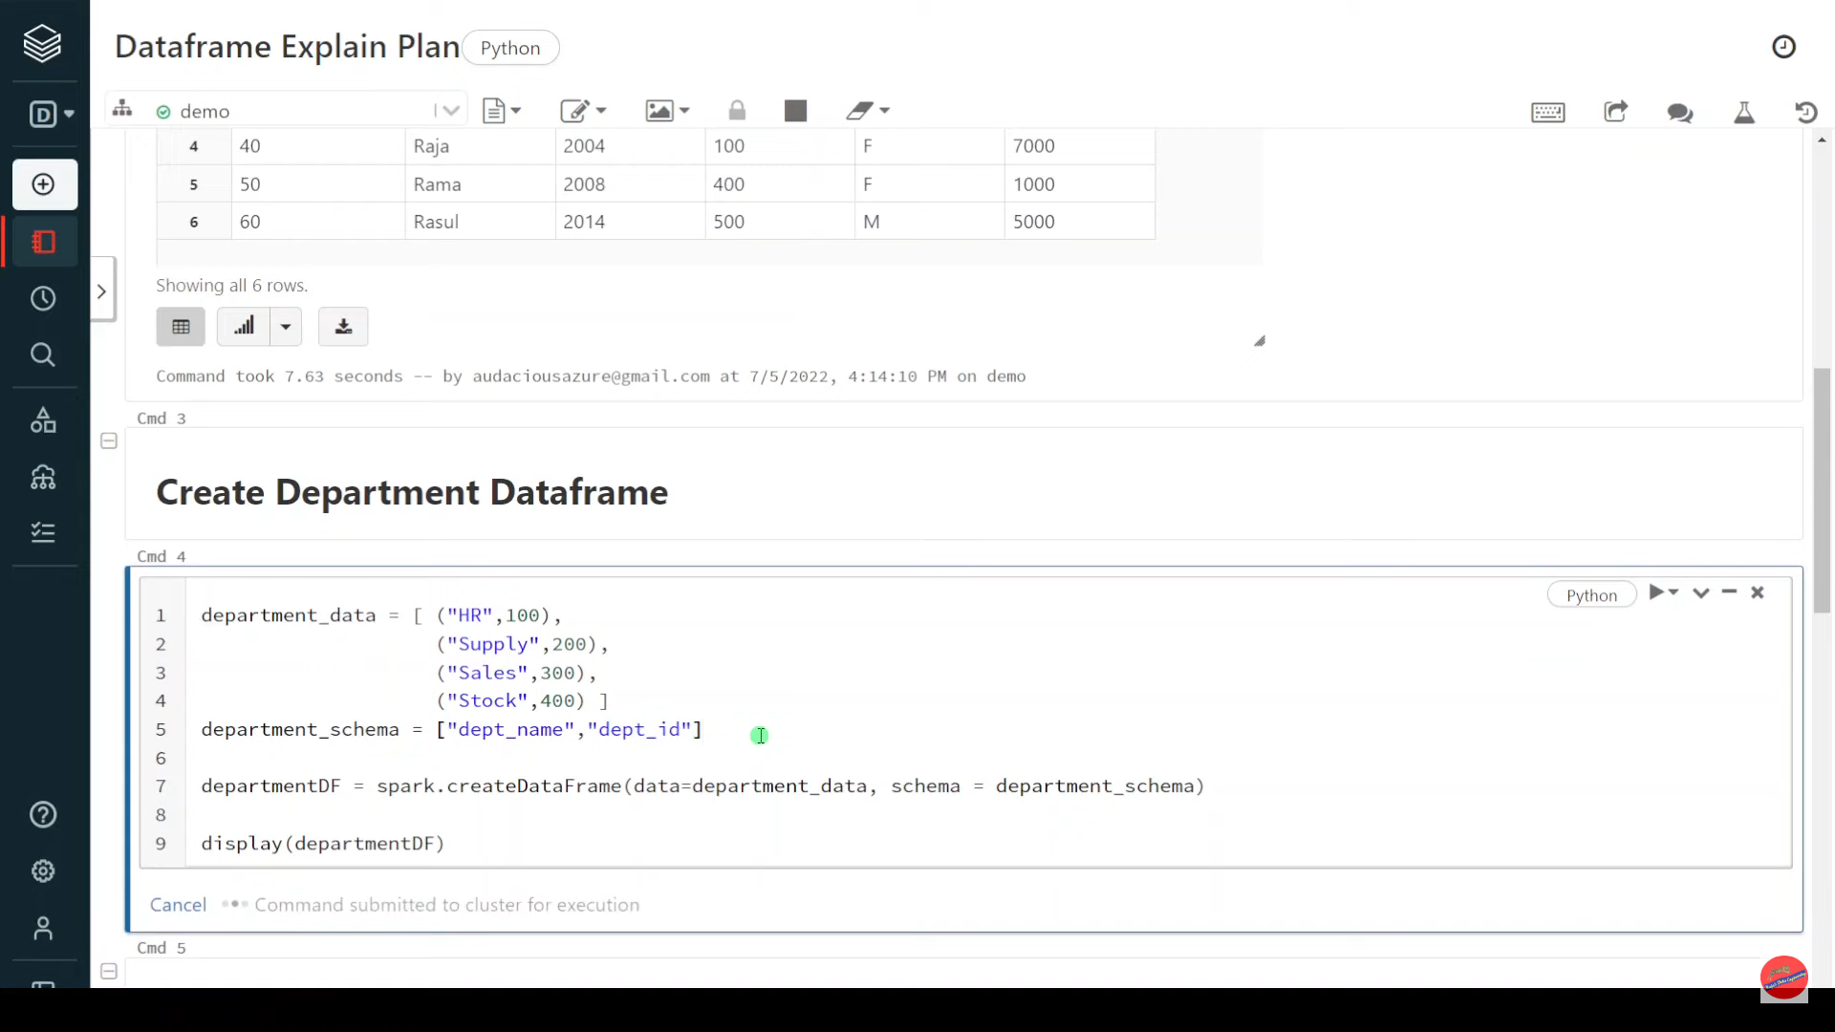

Slide 54


Slide 55
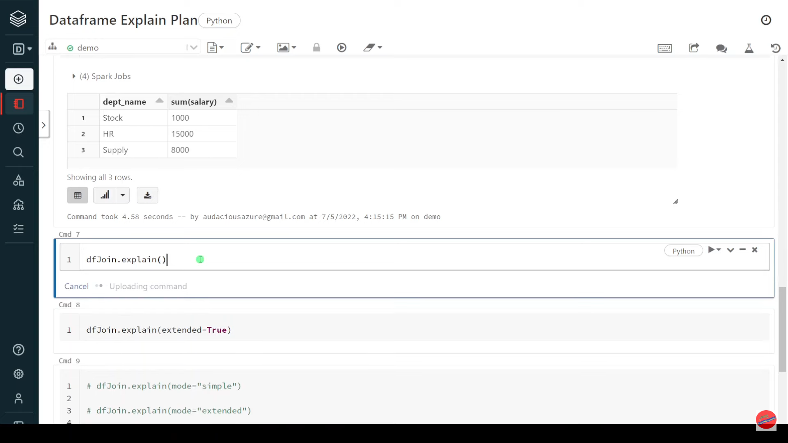

Slide 56
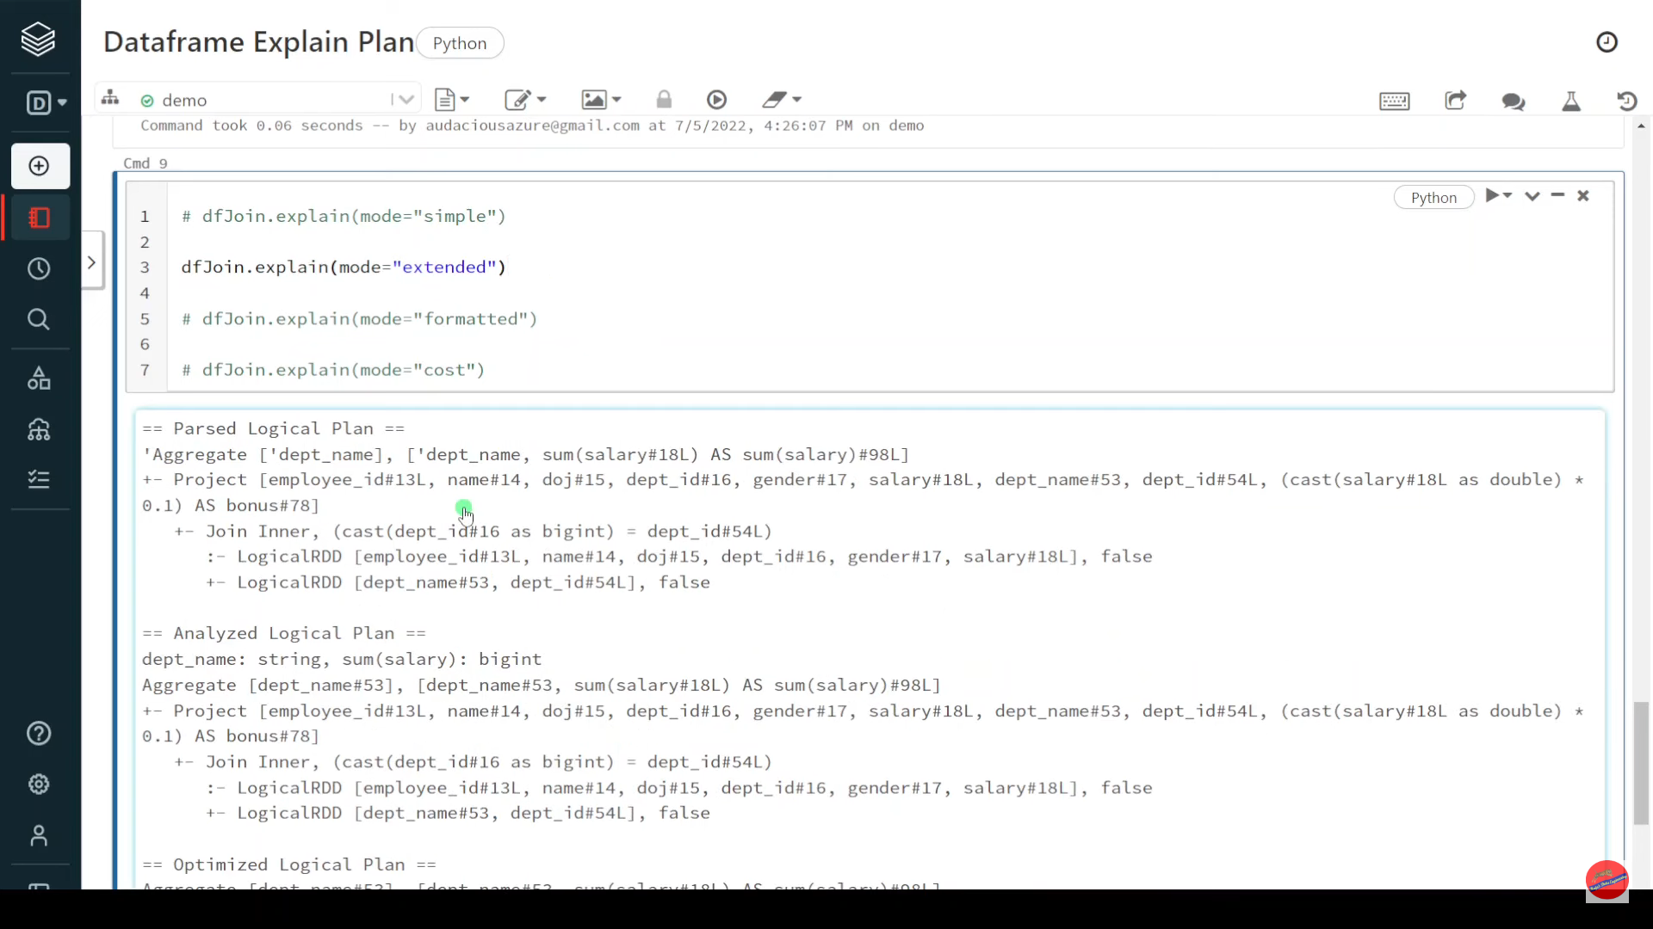

Slide 57
Pyspark | UDF to Check if Folder Exists

Slide 58
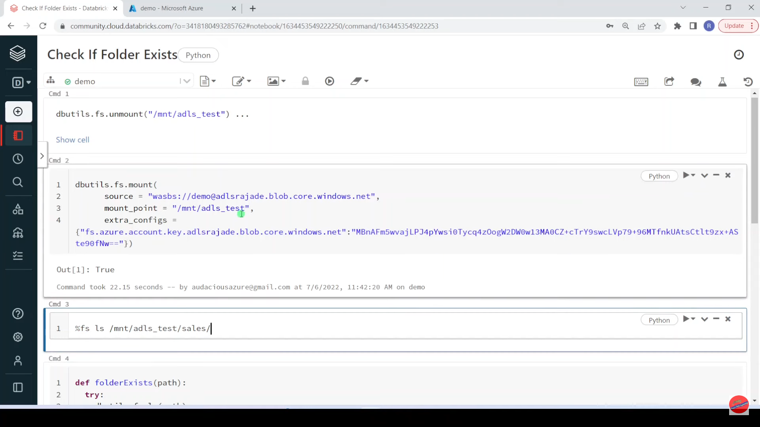

Slide 59
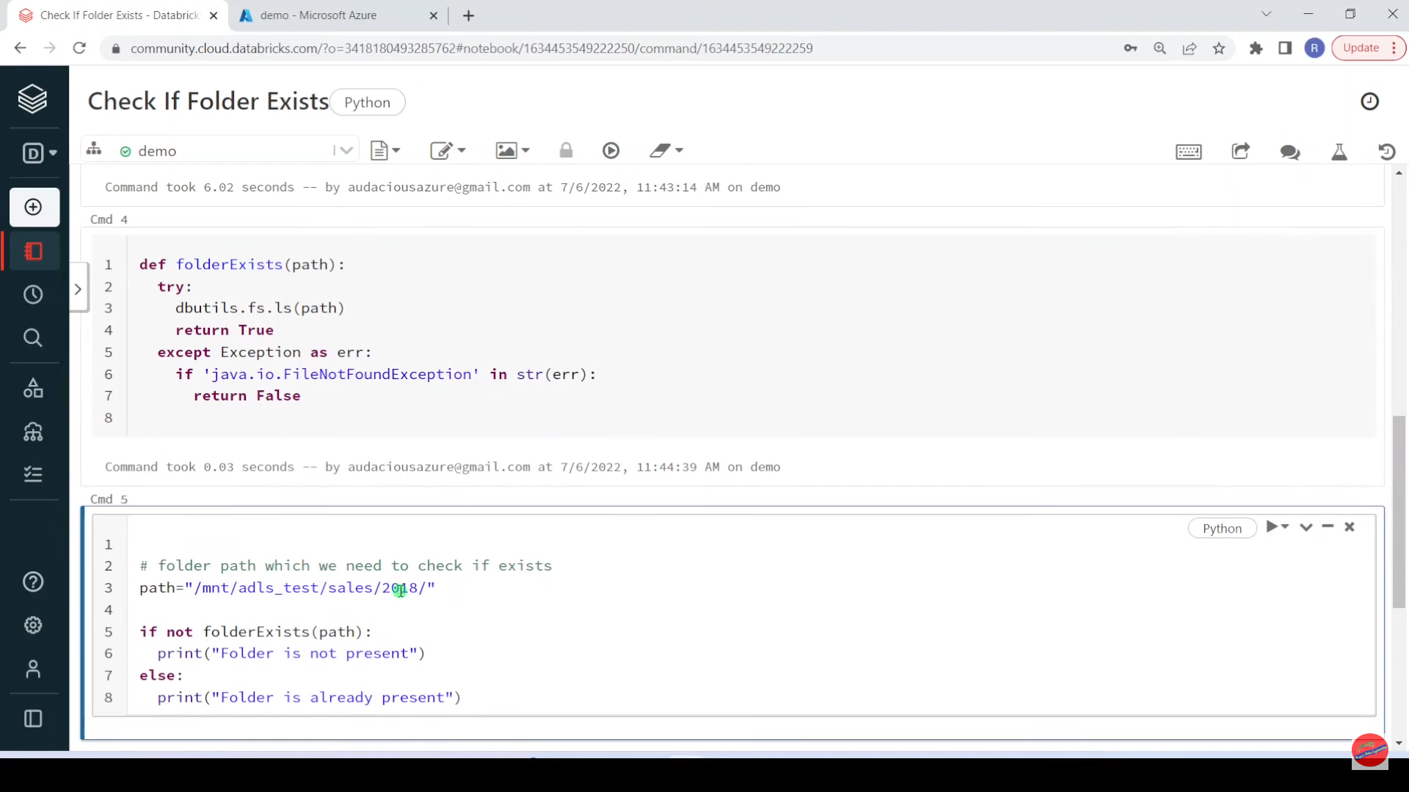

Slide 60
Pyspark | Interview Question: Sort-Merge Join (SMJ)

Slide 61
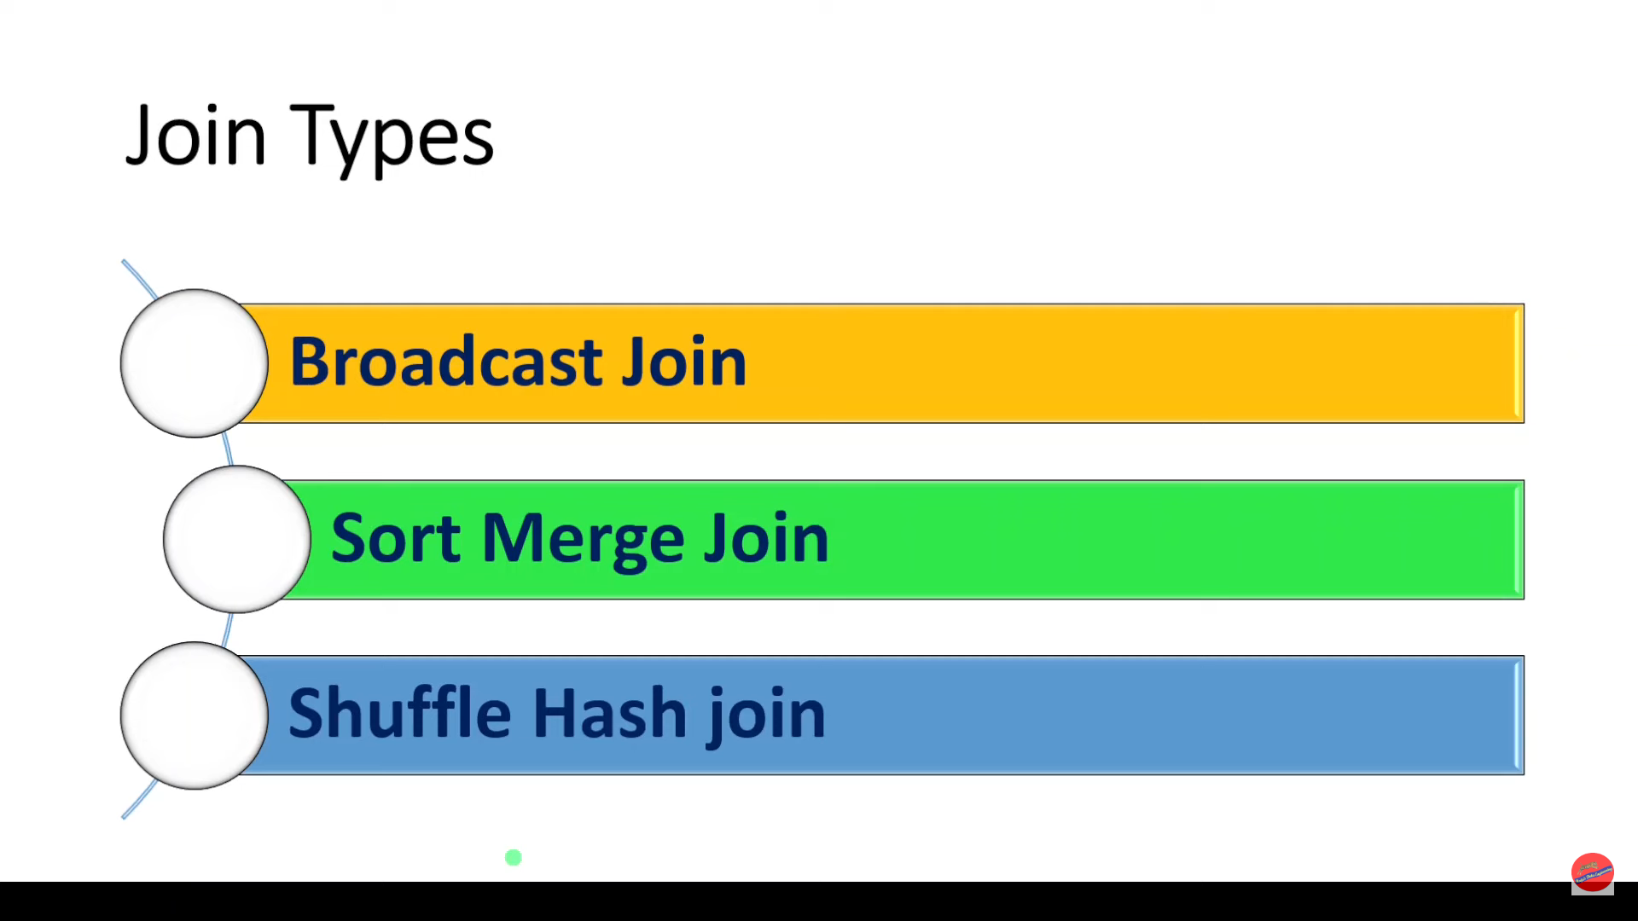

Slide 62
Sort-Merge : By default , Spark uses this method while joining data frames. It’s two step process. First all executors should exchange data across network to sort and re-allocate sorted partitions. At the end of this stage , Each executor should have same key valued data on both data frame partitions so that executor can do merge operation. Marge is very quick thing.
Sort Phase : As you can see, both A and B are sorted by Join key i.e. Key column and sorted data is split into 2 partitions . Each partition should have specific key data. There should not be any overlapping of Keys between partitions which is hole idea of shuffling.
Merge Phase : Merging sorted data by keys is very simple and quickest operation.
Broad Cast Join : We have observed , Sort-Merge join requires full shuffling of both data sets via network which is heavy task for Spark . What if we can eliminate shuffling.

